Slide 1
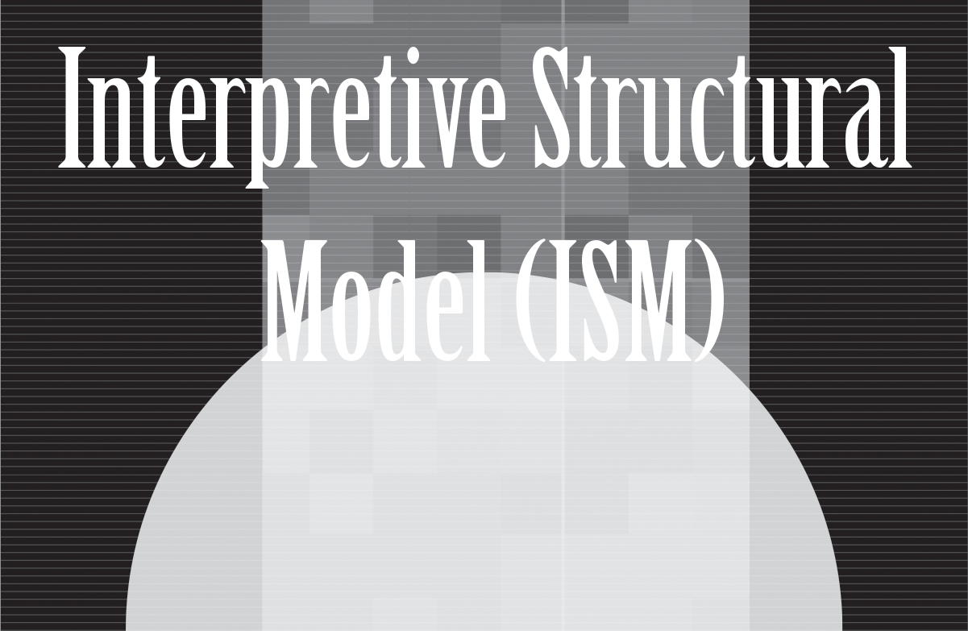
Instructor’s
Title & Name
Course Title….

Slide 2
Copyright © 2021 by the authors (A. Ertas and U. Gulbulak). This is an open access article distributed under the Creative Commons Attribution License (https://creativecommons.org/licenses/by/4.0/), which permits unrestricted use, distribution, and reproduction in any medium, provided the original work is properly cited.

Slide 3
Transdisciplinarity
Transdisciplinarity is a method of acquiring new knowledge through rethinking current methods and processes, rearranging our fundamental science and engineering knowledge to create innovative technological products and services to confront society’s complex issues. The practical focus of transdisciplinarity is a collaborative process to improve our understanding of complex issues by using collective intelligence through collective experts and multiple resources for designing and implementing solutions to challenging problems by considering the public good.

Slide 4
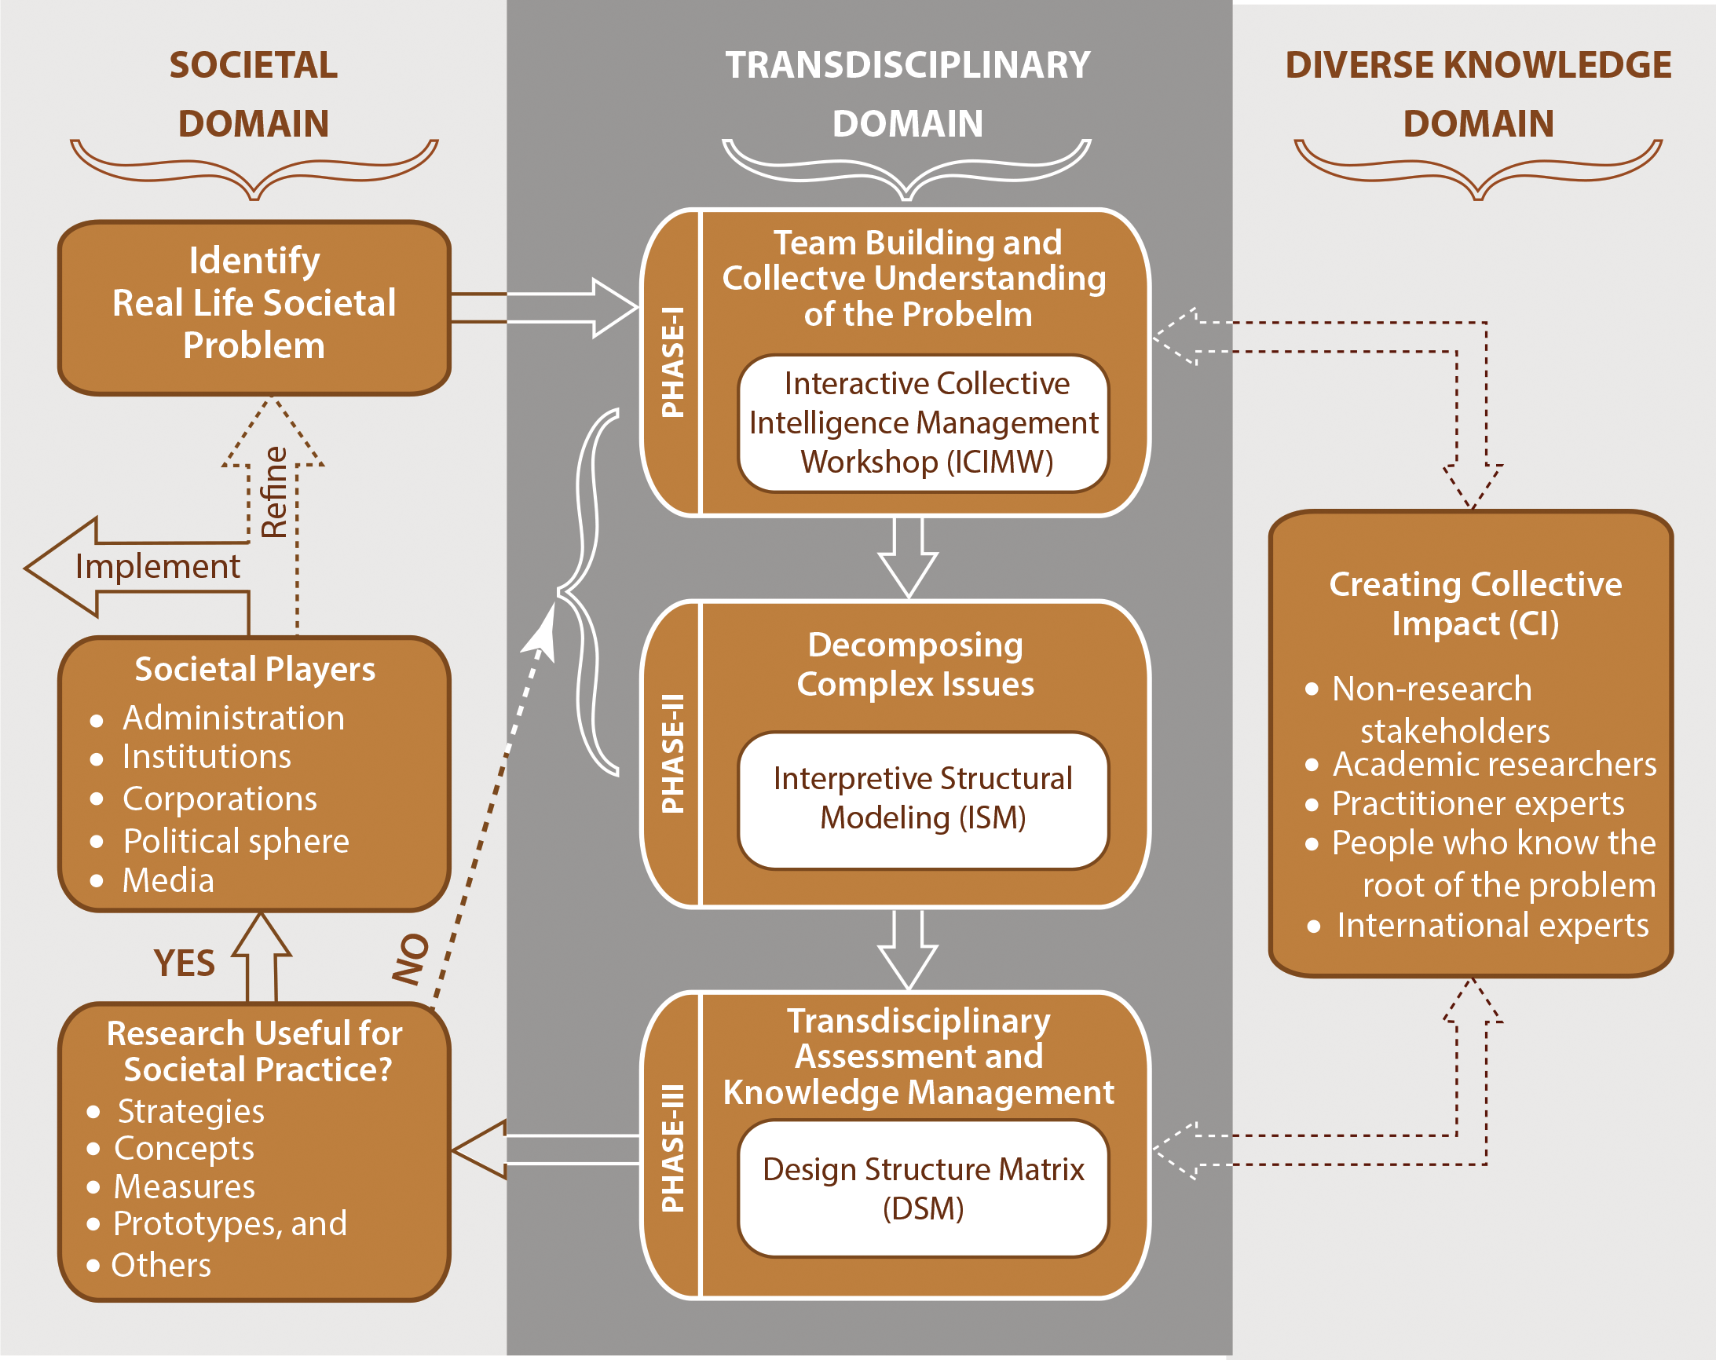
Figure 4.1: Transdisciplinary Research Process

Slide 5
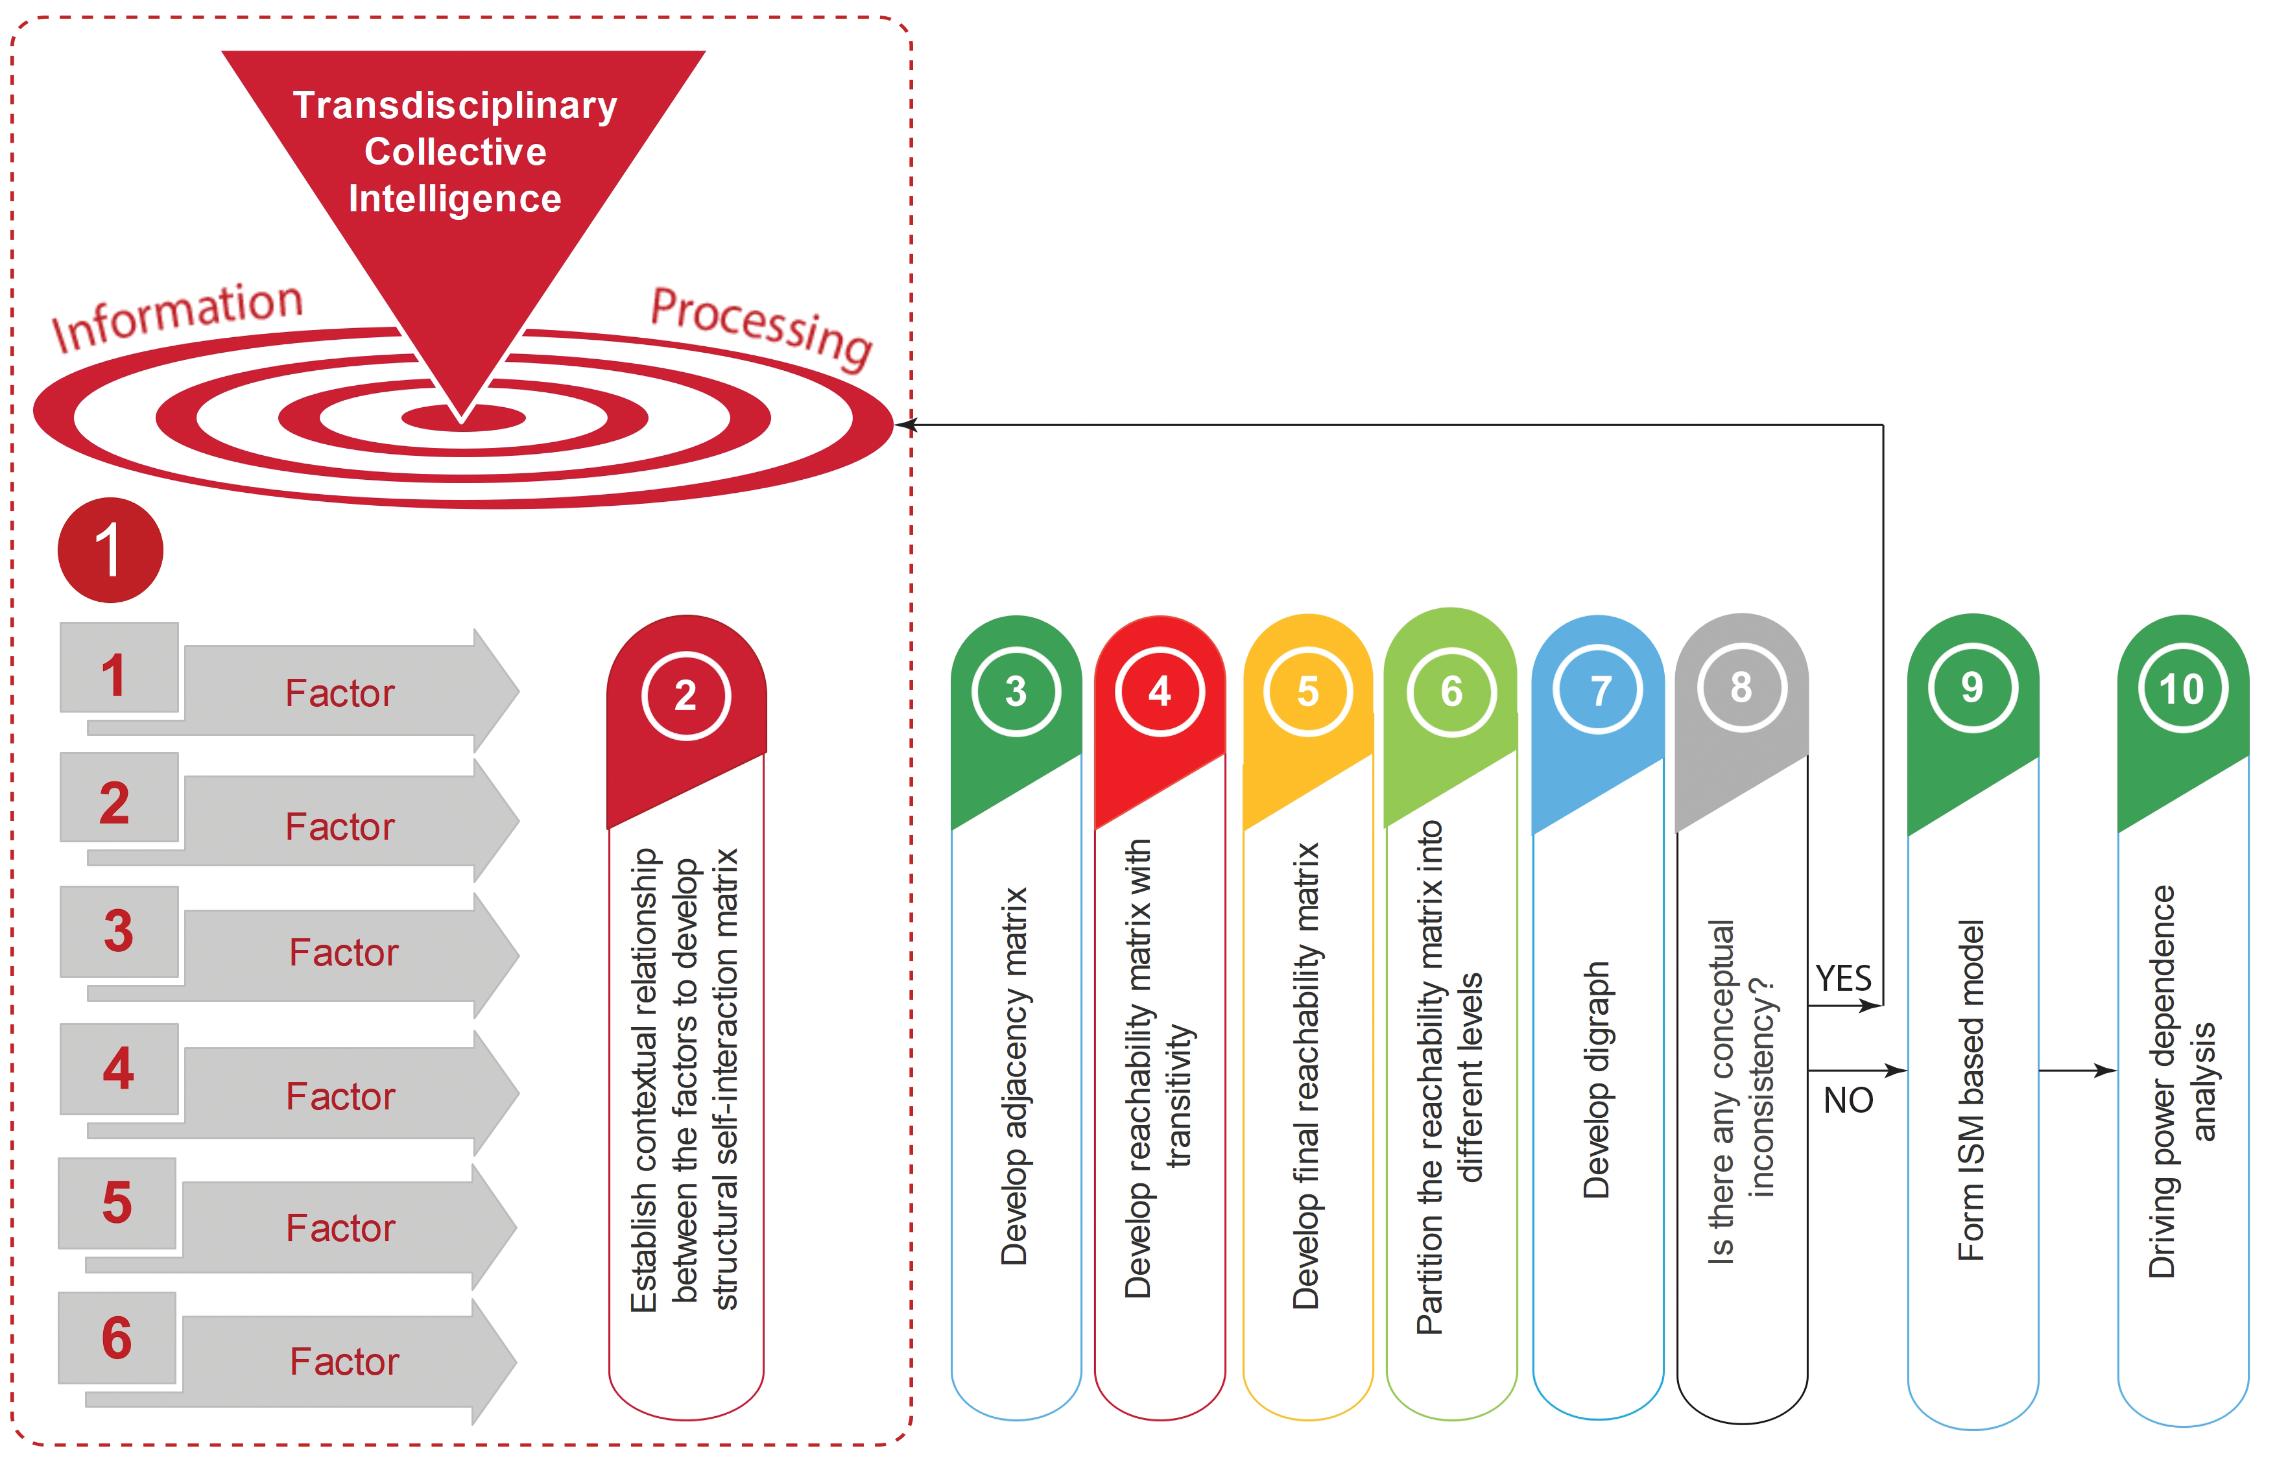
Figure 4.2: ISM process.

Slide 6
Step 1: Development of TD collective intelligence
ISM approach starts with the development of transdisciplinary (TD) collective intelligence which includes identifying main factors affecting complexity and establishing a contextual relationship between the factors (Step-1) to develop Structural Self-Interaction Matrix (SSIM) (Step-2). This will be accomplished by exercising the Interactive Collective Intelligence Management workshop.

Slide 7
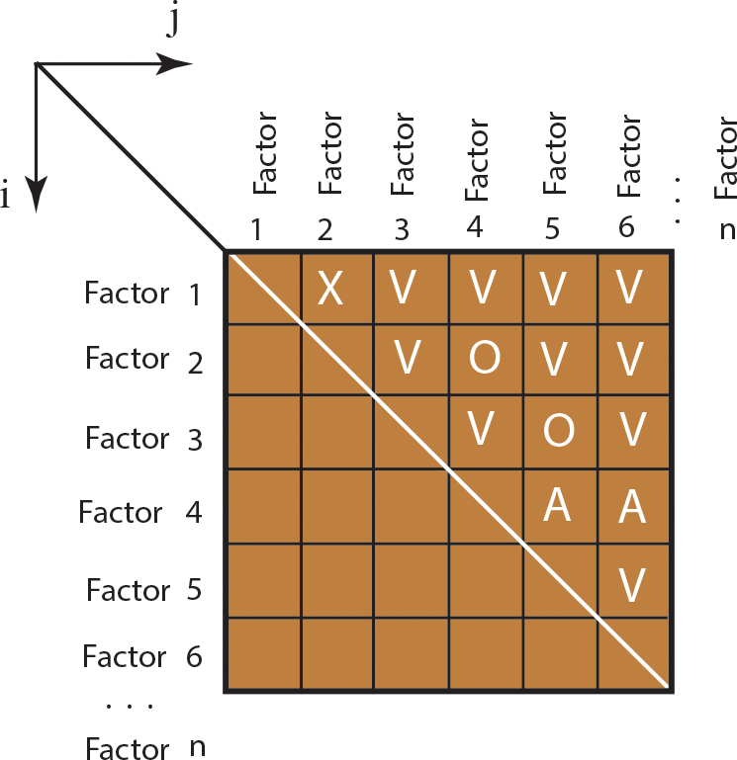
Step 2: Develop Structural Self-Interaction Matrix
• V = for the relation from i to j but not in both directions;
• A = for the relation from j to i but not in both directions;
• X = for both-direction relations: from i to j and j to i; and
• O= if the relation between the elements does not appear
to be valid
Figure 4.3: Structural self-interaction matrix (SSIM).

Slide 8
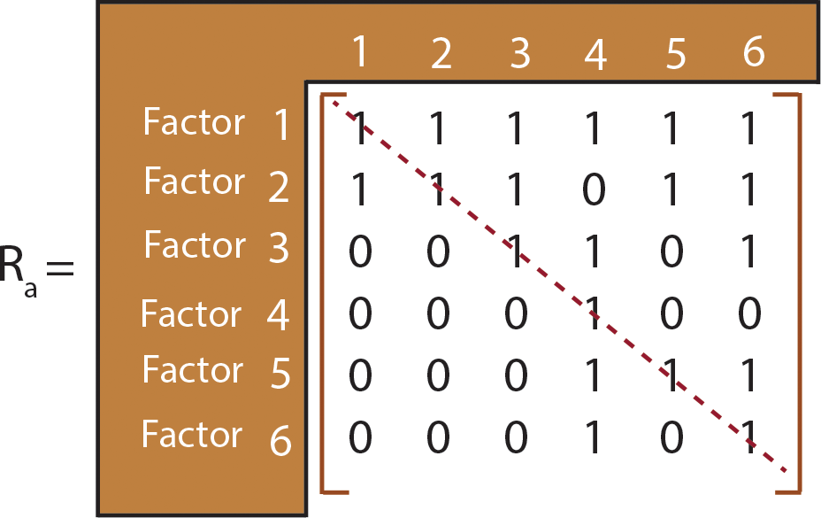
STEP 3: Develop Adjacency Matrix
As shown in Figure 4.4, replace the entries V, A, X,
and O of the SSIM into 1 and 0 (binary matrix).
Figure 4.4: Adjacency matrix.

Slide 9
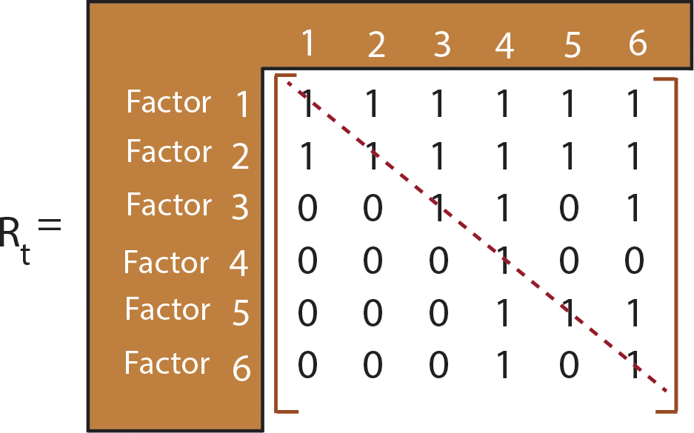
STEP 4: Reachability Matrix with Transitivity
Figure 4.5 shows the reachability matrix with transitivity. The reachability matrix is tested for the transitivity rule and is updated until transitivity is confirmed. The transitive rule is “if A has a relationship to B and B has a relationship to C, then A has relationship to C”. Following the transitivity rule reachability matrix, 𝑅𝑡 shown in Figure 4.5 is developed.
Figure 4.5: Reachability matrix with transitivity.

Slide 10
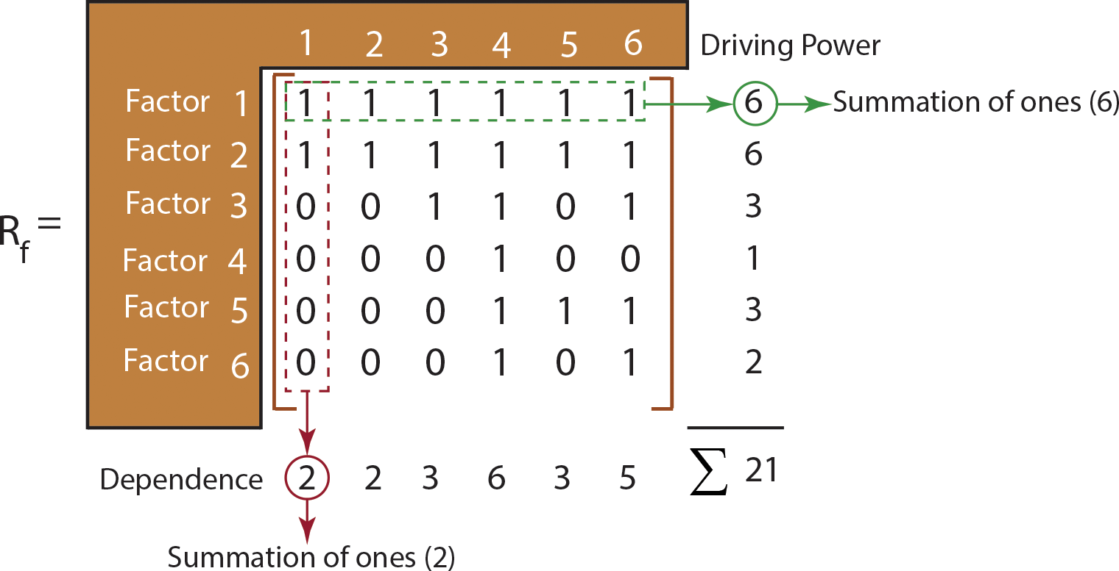
STEP 5: Final Reachability Matrix
The final reachability matrix in Figure 4.6 shows the driving power and dependence of factors. The summation of ones in the corresponding rows gives the driving power and the summation of ones in the corresponding columns gives the dependence. Figure 4.6 is the final form of the relationships of all the factors involved with the problem under consideration. Calculated driving power and dependence in Figure 4.6 will be used for MICMAC analysis.
Figure 4.6: Final reachability matrix.

Slide 11
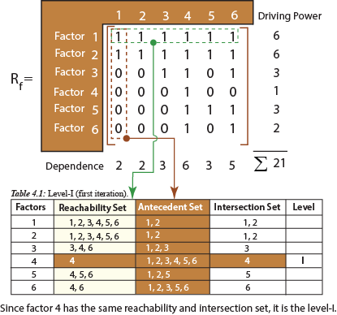
STEP 6: Level Partition
When the factors of the intersection and reachability sets are the same, then that factor will be identified as the top-level group (level I group) in the ISM hierarchy. Once the top-level factors are identified, they are deleted from the set to identify the next level. As seen from Tables 4.1 through 4. 4, this iteration process is repeated until all the levels are identified. These levels will be used to build the digraph and ISM model.
Figure 4.7: Identifying level 1

Slide 12
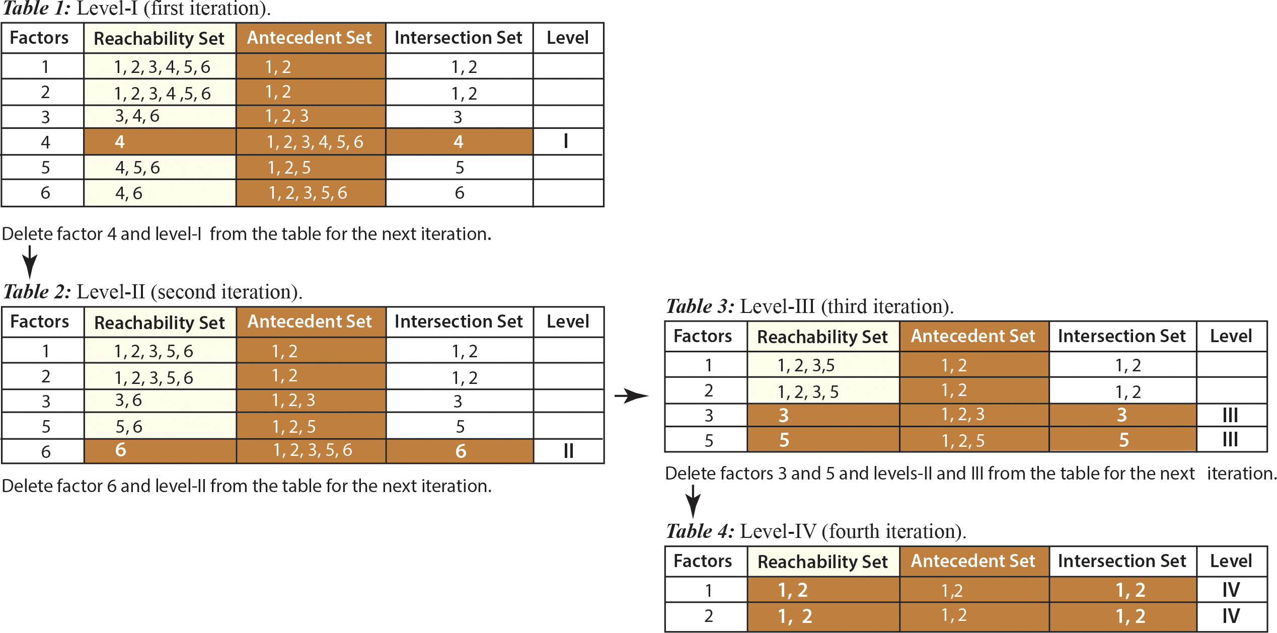

Slide 13
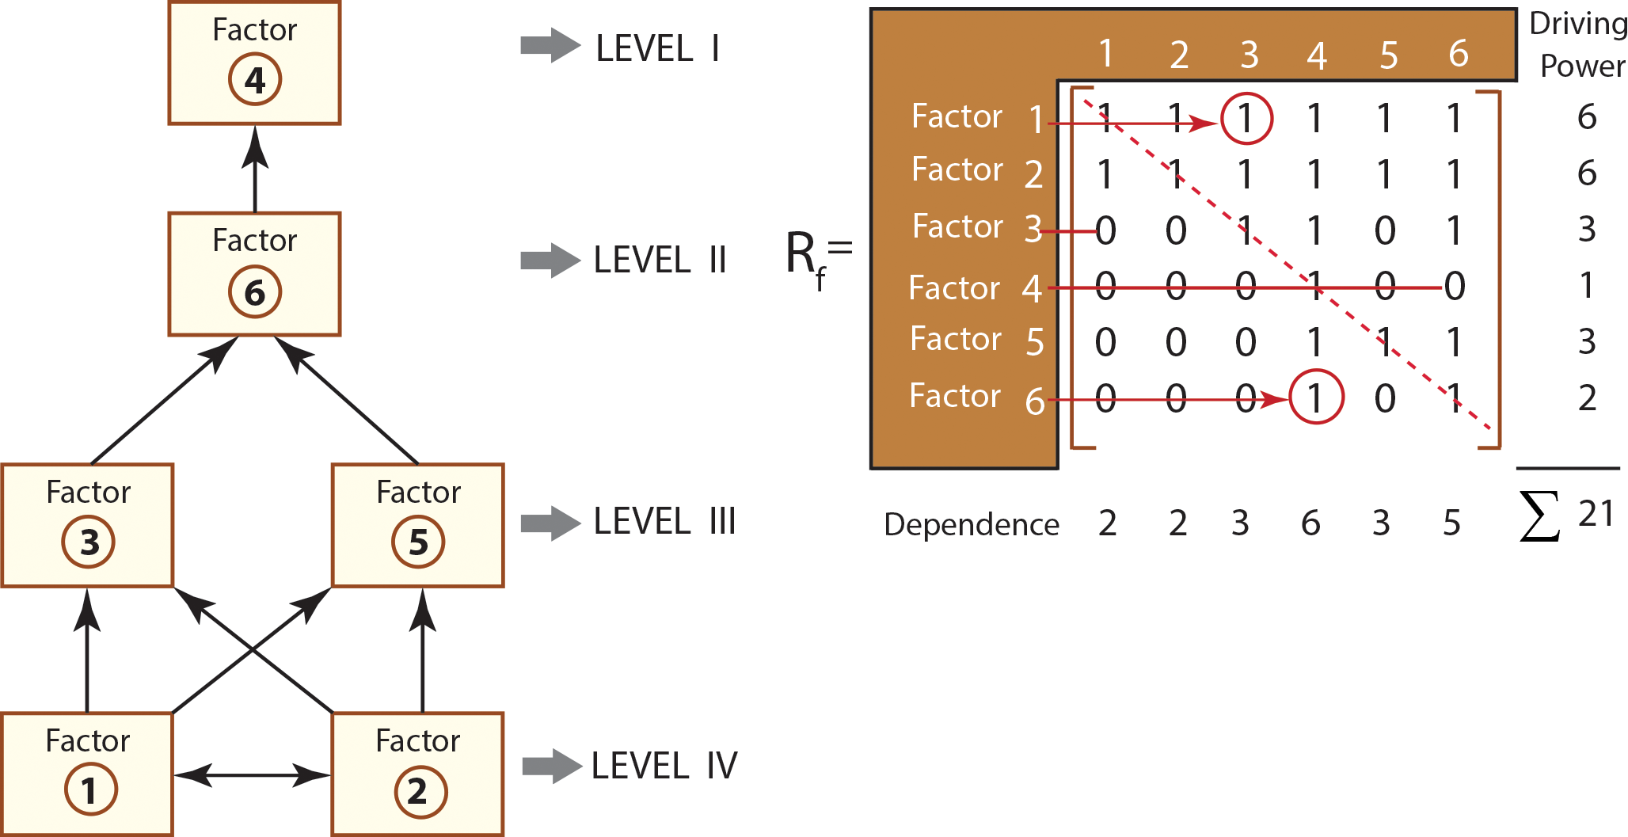
STEP 7: Formation of Digraph
Figure 4.8: Digraph.

Slide 14
STEP 8: If there is any conceptual inconsistency, go back to Steps 1 and 2 to re-iterate the problem – carefully check the relationships among the factors.

Slide 15
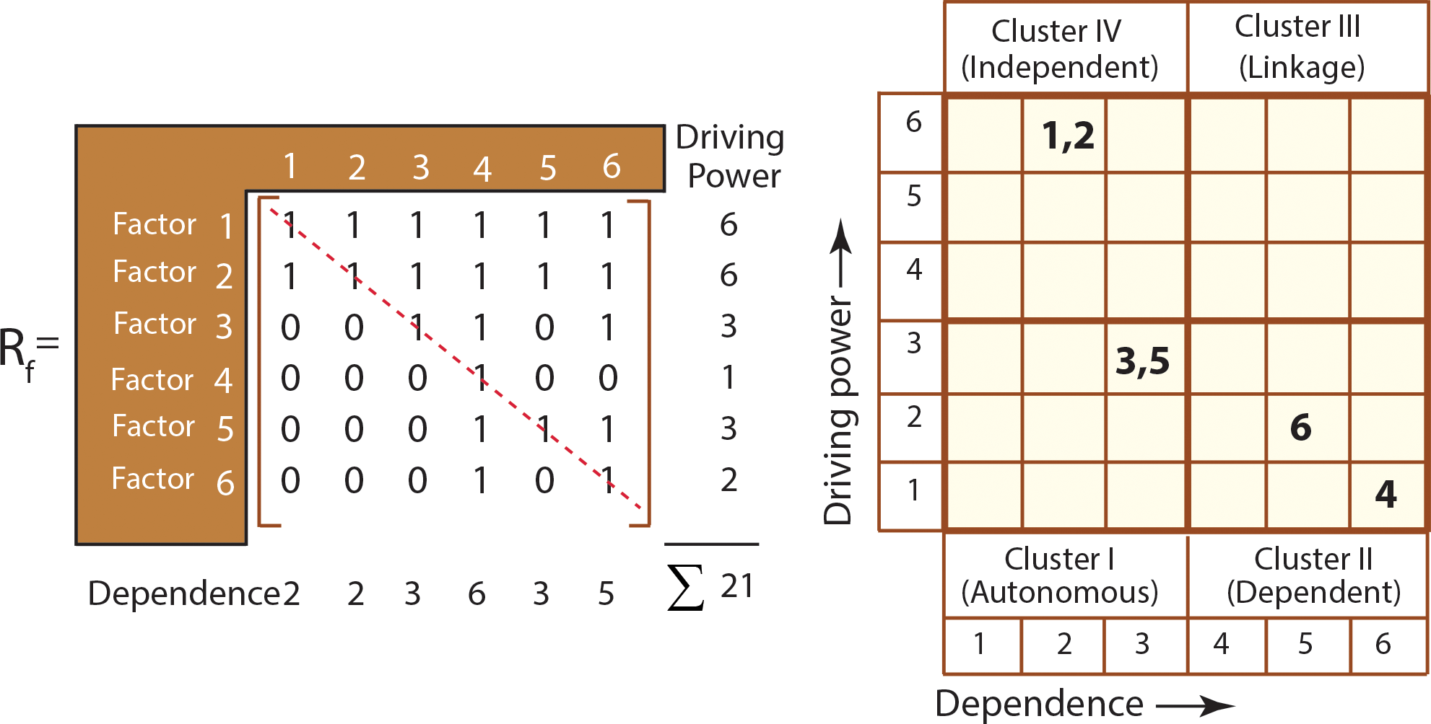
STEP 9-10 MICMAC Analysis
Figure 4.9: MICMAC analysis.

Slide 16
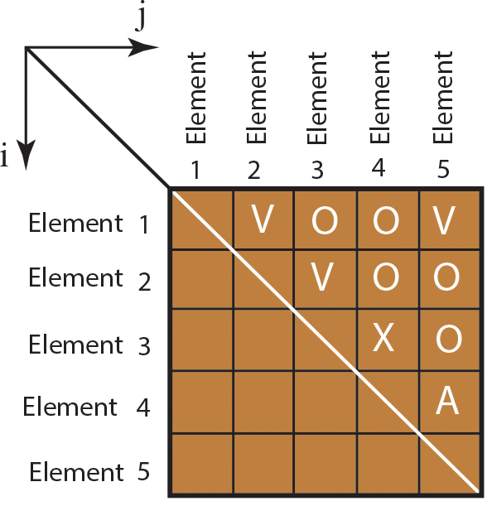
Example 4.1
Figure 4.10 shows the relationships of five elements of a system. Develop:
(a) the adjacency matrix;
(b) the final reachability matrix;
(c) the level partition;
(d) the digraph.
Figure 4.10: Structural self-interaction matrix.

Slide 17
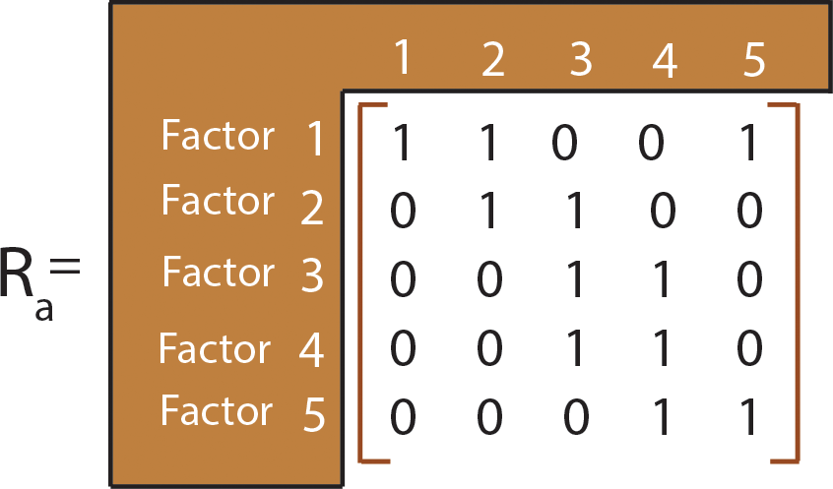
(a) The adjacency matrix shown in Figure 4.11 is obtained by transforming SSIM into a binary matrix by substituting V, A, X, and O by 1 and 0.
Figure 4.11: Adjacency matrix.

Slide 18
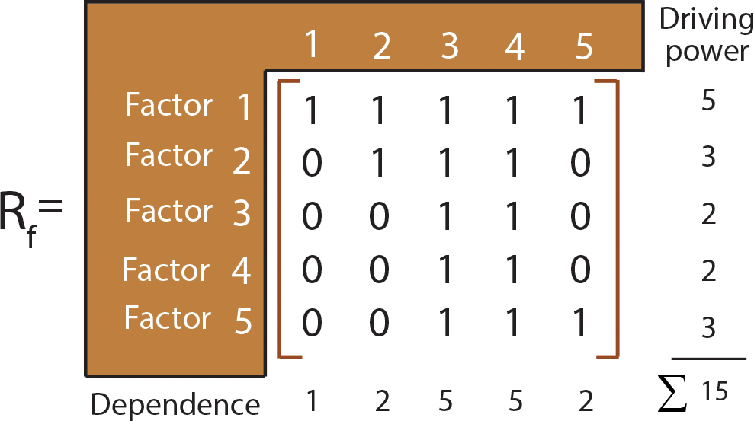
(b) Final Reachability matrix with transitivity is shown in Figure 4.12. As shown in this figure, the summation of ones in the corresponding rows gives the driving power of 15 and the summation of ones in the corresponding columns gives the dependence of 15.
Figure 4.12: Final reachability matrix with transitivity.

Slide 19
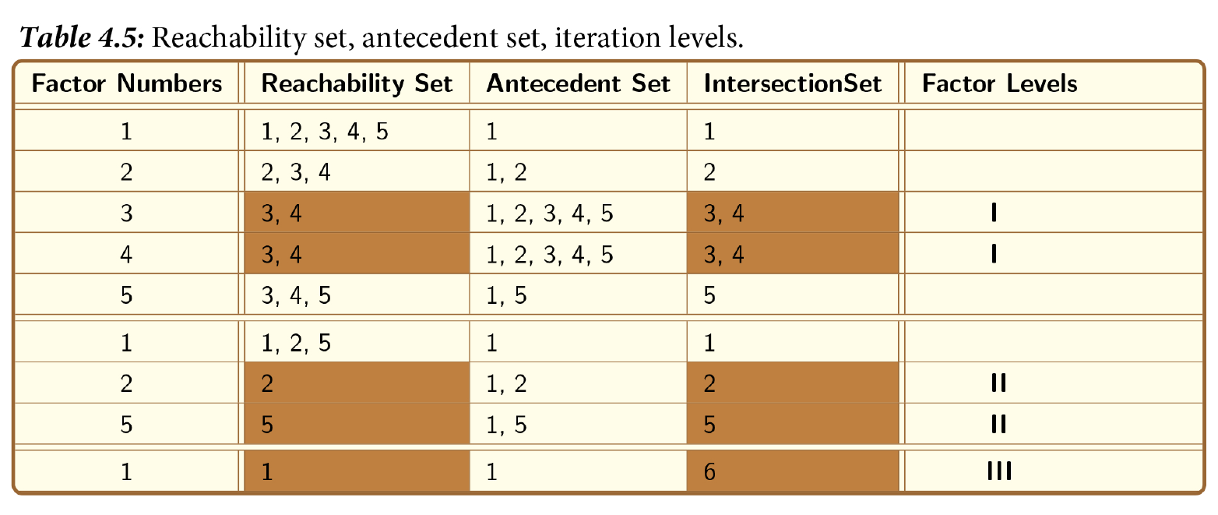
(c) The final reachability matrix is used to develop the level partition.

Slide 20
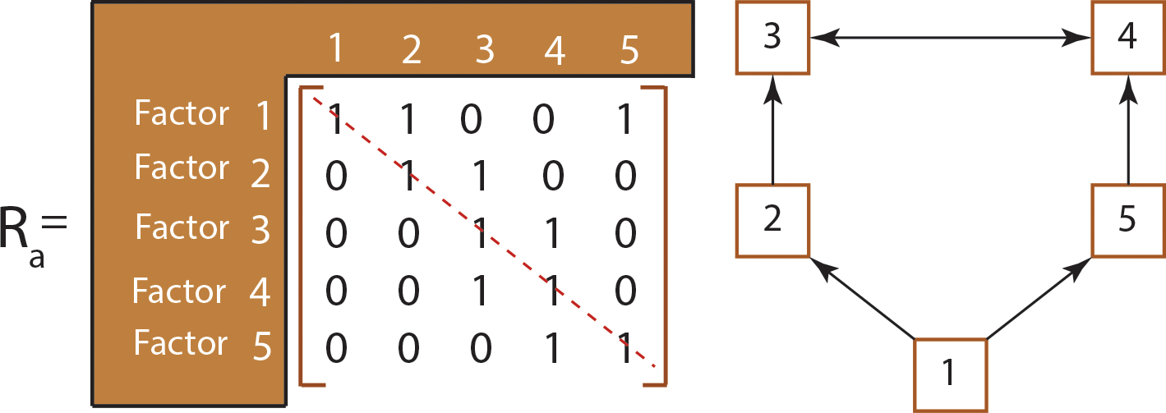
(d) As shown in Figure 4.13, the initial digraph can be developed by using an adjacency matrix.
Figure 4.13: Digraph through adjacency matrix.

Slide 21
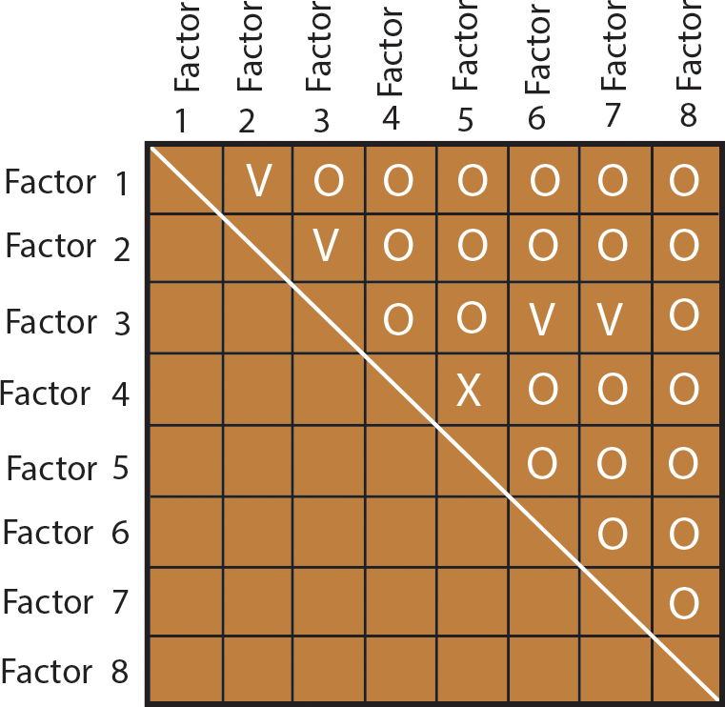
EXAMPLE 4.2
Figure 4.14 shows the relationships of eight elements of a system. Develop:
(a) the adjacency matrix;
(b) the final reachability matrix;
(c) the digraph.
Figure 4.14: Structural self-interaction matrix.

Slide 22
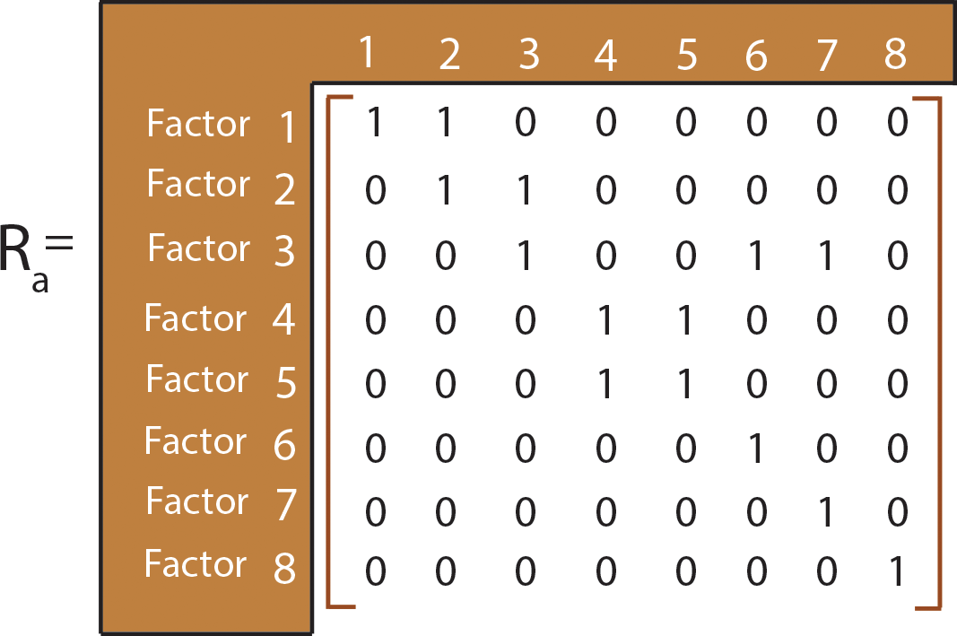
(a) The adjacency matrix shown in Figure 4.15 is obtained by transforming SSIM into a binary matrix by substituting V, A, X, and O by 1 and 0.
Figure 4.15: Adjacency matrix.

Slide 23
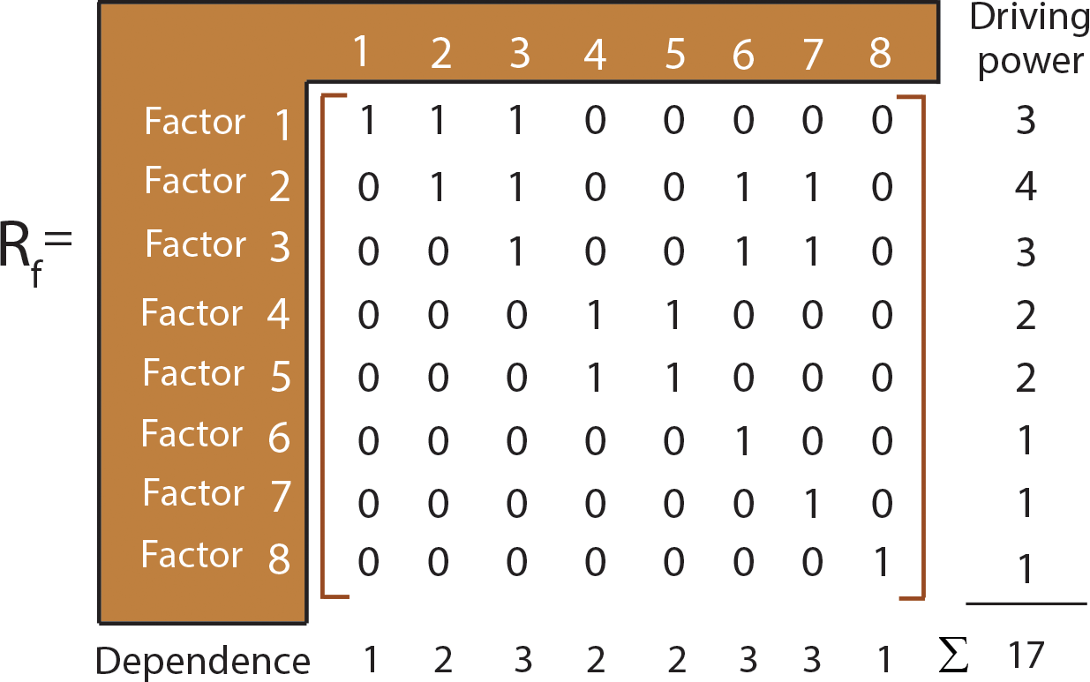
(b) Final Reachability matrix with transitivity is shown in Figure 4.16.
Figure 4.16: Final reachability matrix with transitivity.

Slide 24
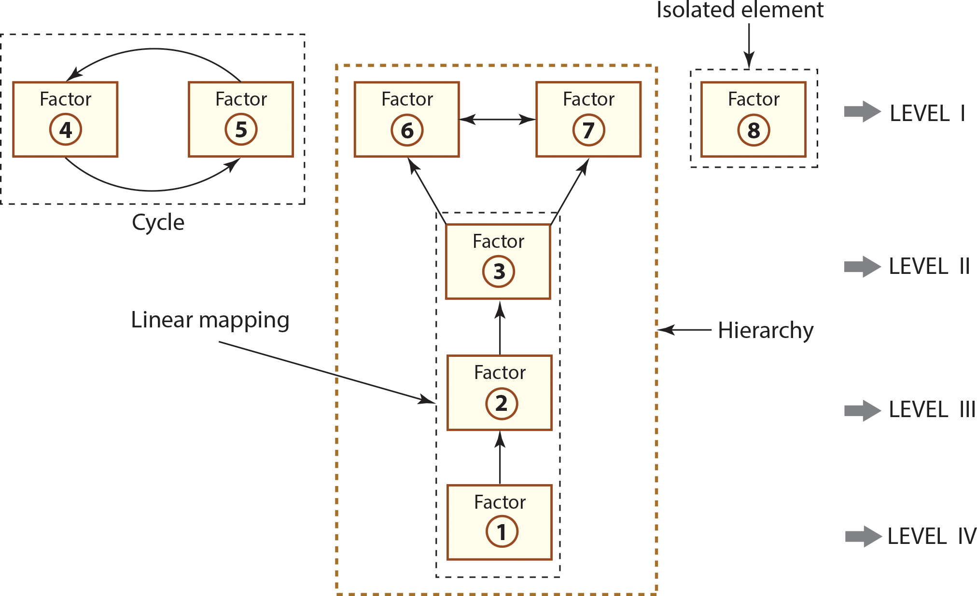
(c) Digraph is shown in Figure 4.17.
Figure 4.17: Digraph.

Slide 25
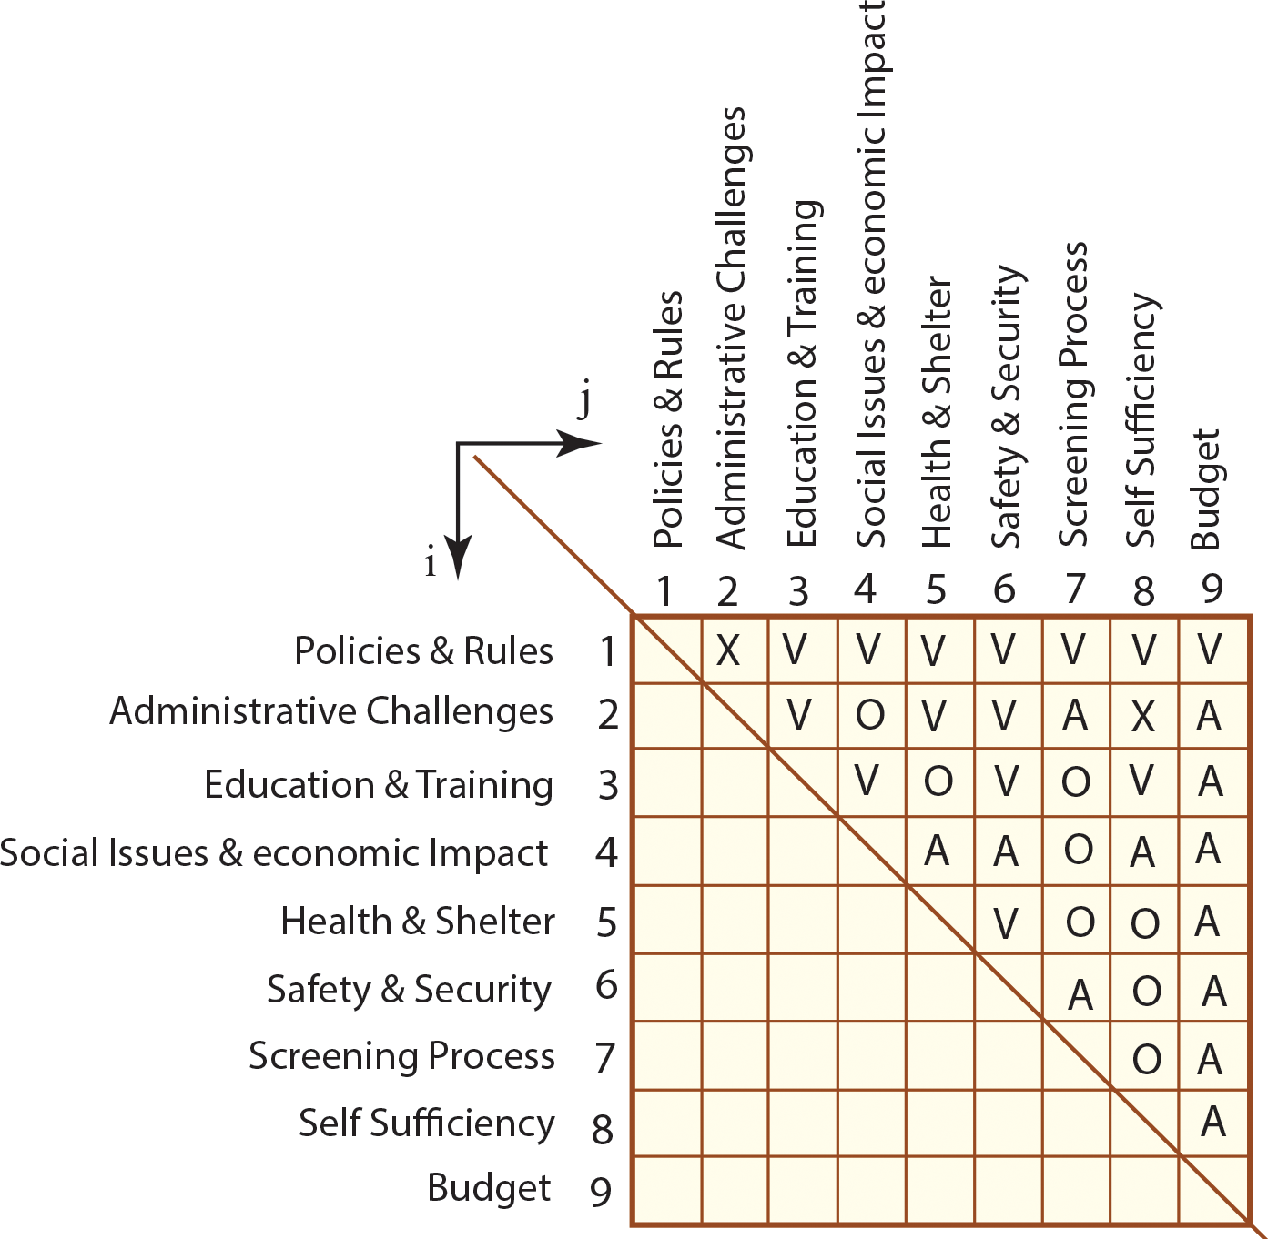
CASE STUDY 4.1
The complexity of Global Refugee Crisis: Needs for Global Transdisciplinary Collaboration.
Figure 4.18: Structural Self-Interaction Matrix (SSIM).

Slide 26
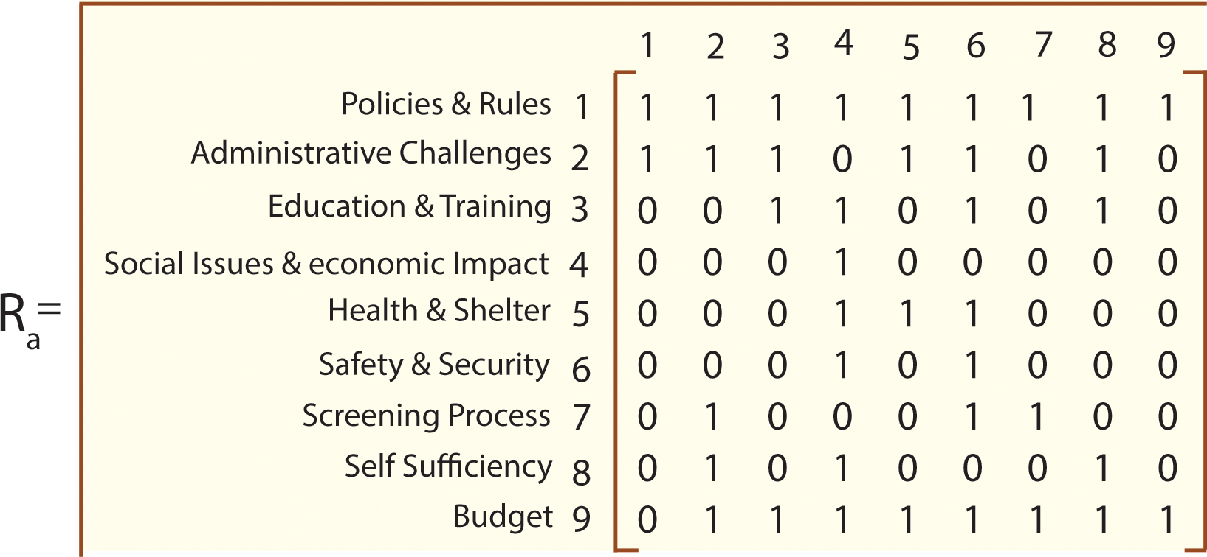
Figure 4.19: Adjacency matrix.

Slide 27
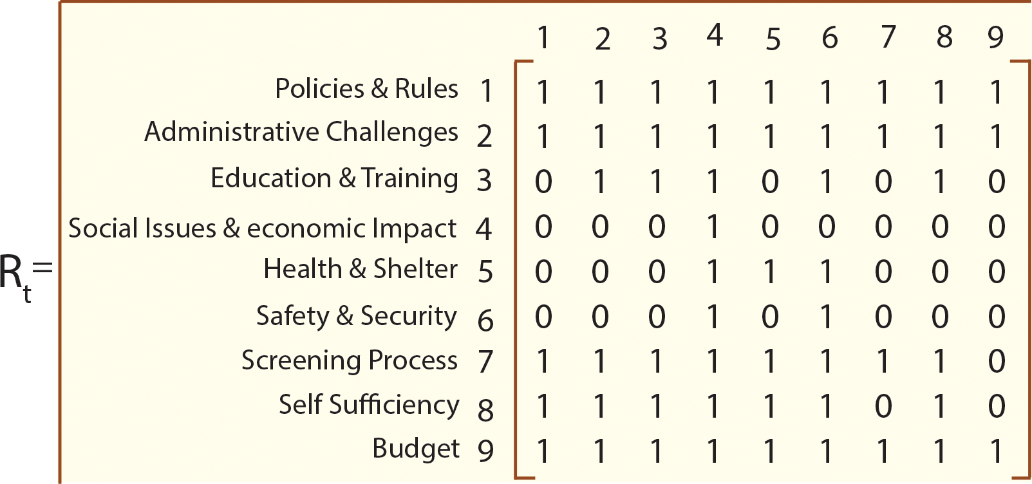
Figure 4.20: Reachability matrix with transitivity.

Slide 28
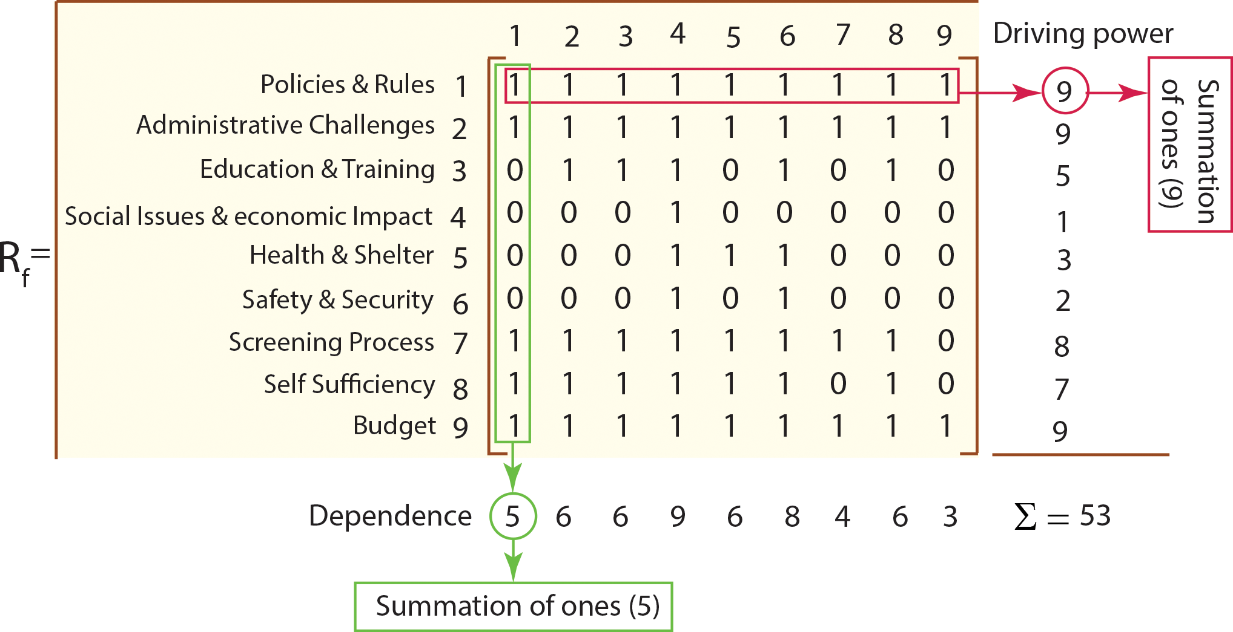
Figure 4.21: Final reachability matrix.

Slide 29
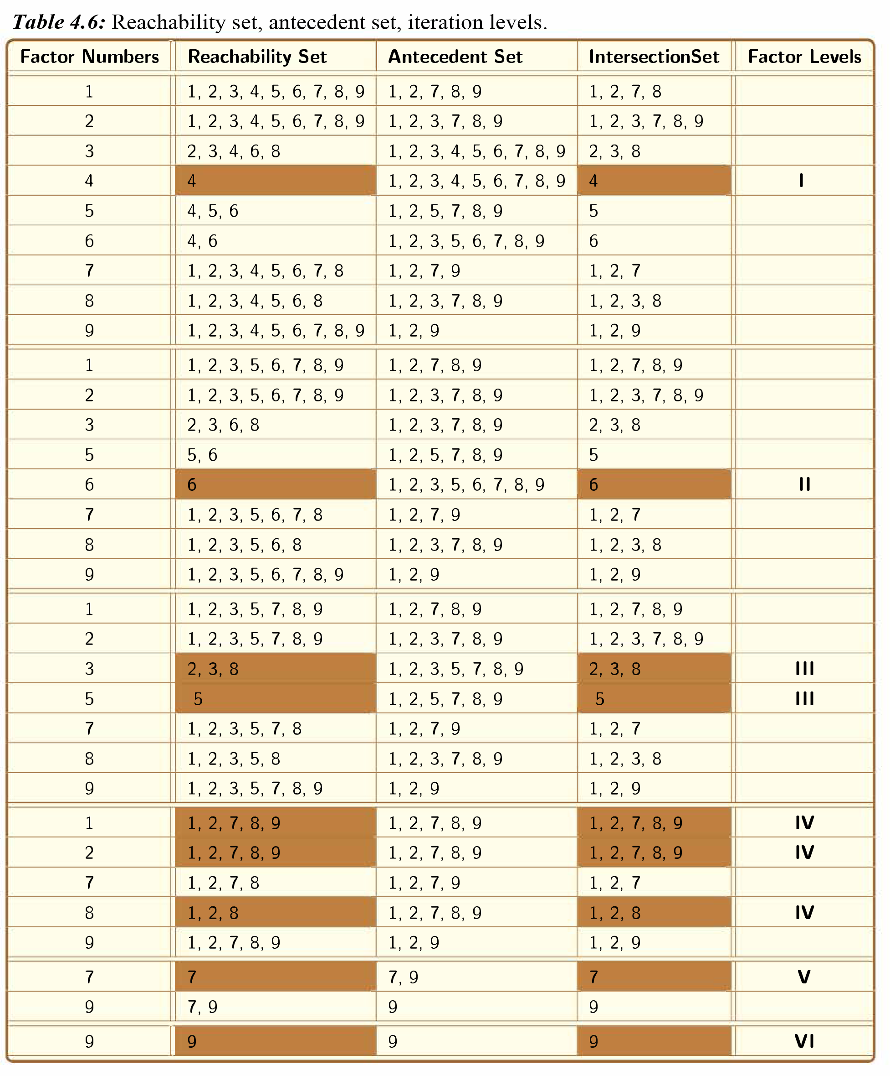

Slide 30
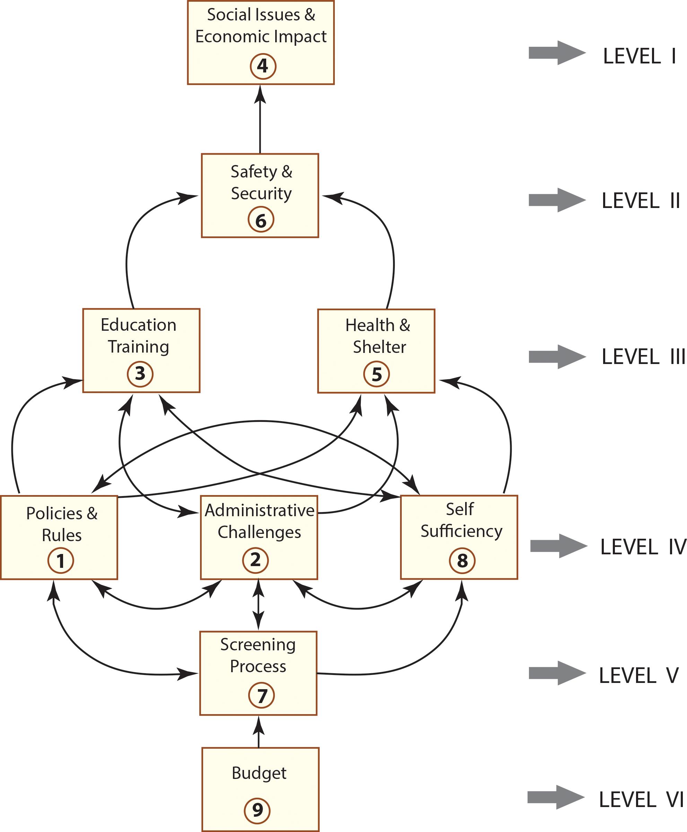
Figure 4.22: Digraph.

Slide 31
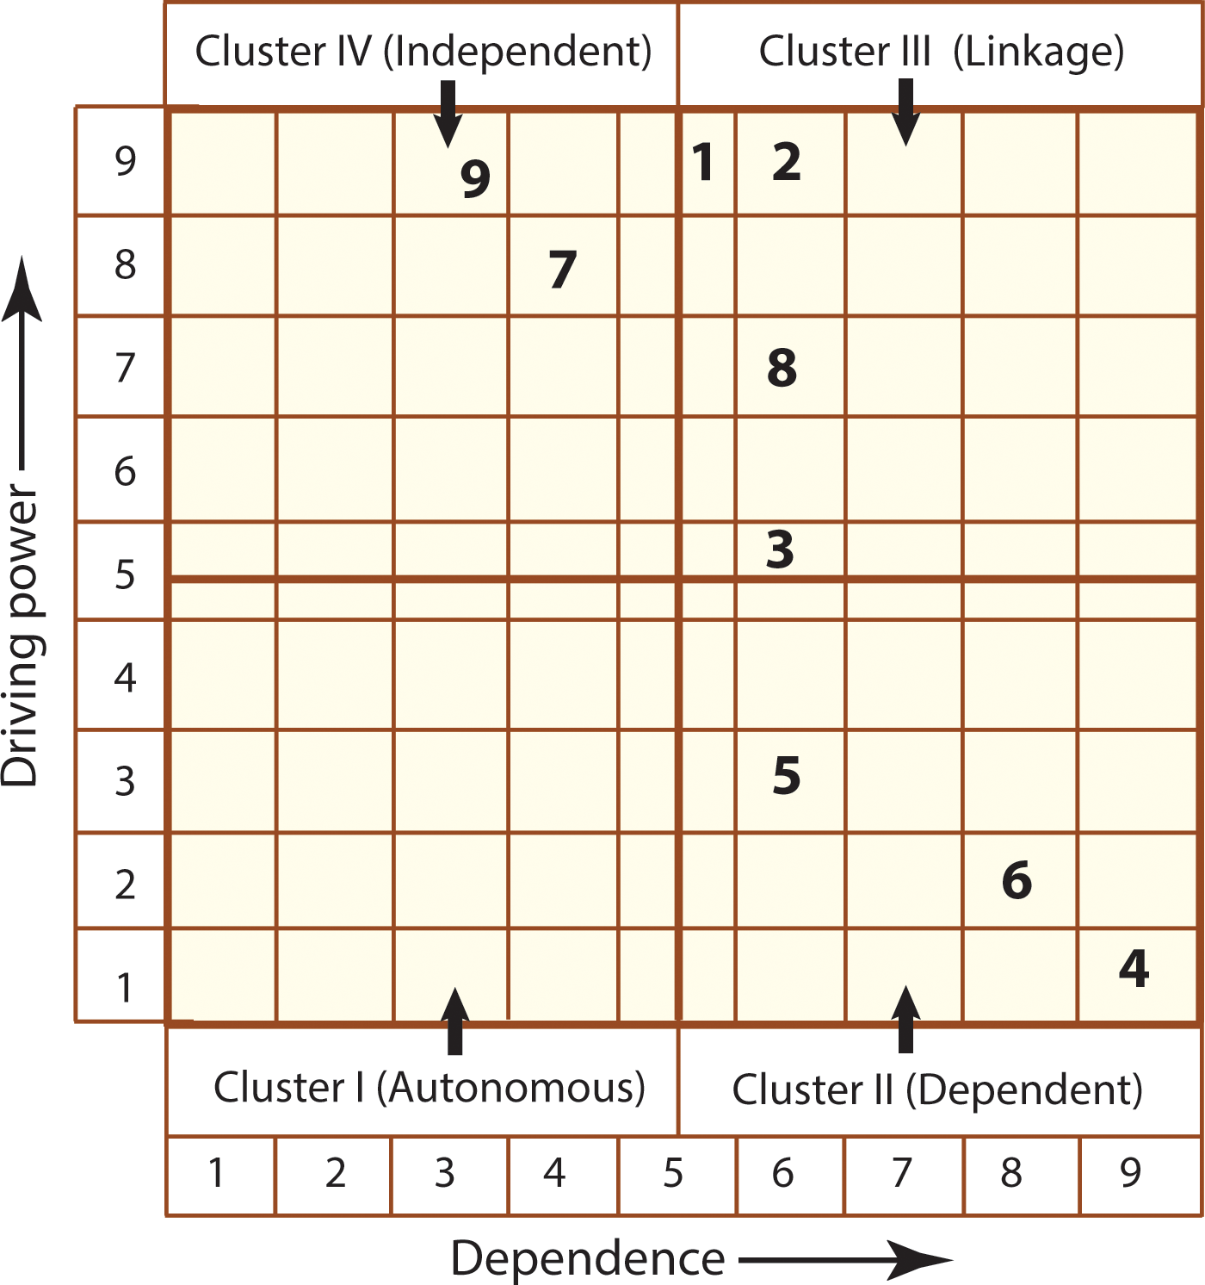
Figure 4.23: MICMAC Analysis.

