Slide 1

Instructor’s
Title & Name
Course Title….

Slide 2
Copyright © 2021 by the authors (A. Ertas and U. Gulbulak). This is an open access article distributed under the Creative Commons Attribution License (https://creativecommons.org/licenses/by/4.0/), which permits unrestricted use, distribution, and reproduction in any medium, provided the original work is properly cited.

Slide 3
Theory of Invention Problem Solving (TRIZ)
“TRIZ” is the Russian acronym for the “theory of inventive problem solving” developed by G.S. Altshuller and his colleagues in Russia between 1946 and 1985.
More than 3 million patents have been analyzed to discover the patterns that predict innovative solutions to problems. These problems which have been solved by someone before, have been collected and organized within TRIZ.

Slide 4
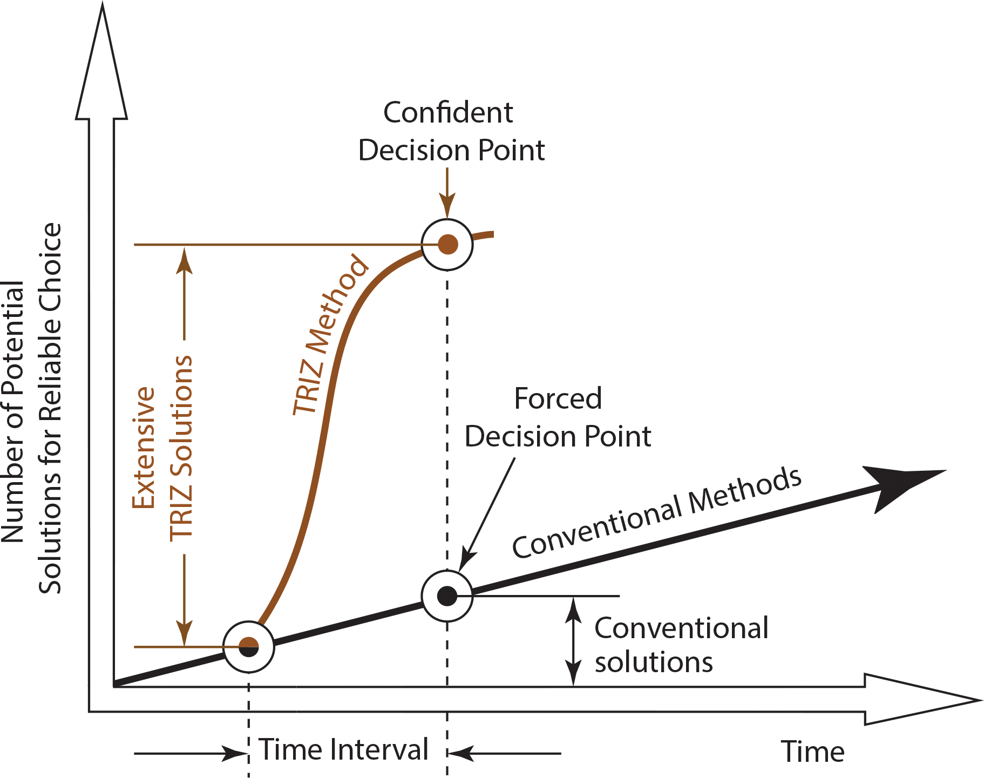
Impact of TRIZ on an Organization
Figure 3.1: Impact of TRIZ on an organization (adapted from reference 7).

Slide 5
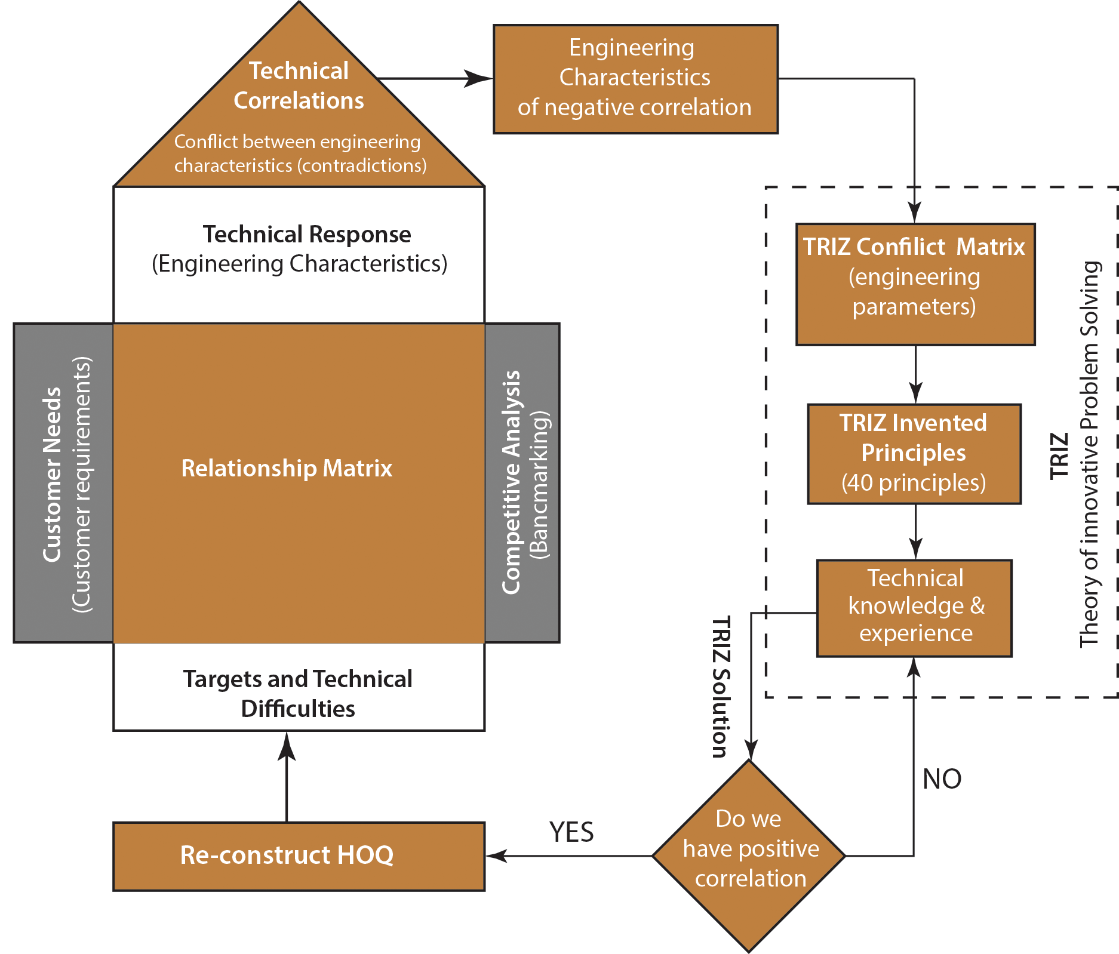
QFD-TRIZ Integration
Figure 3.2: QFD-TRIZ Integration Flow chart.

Slide 6
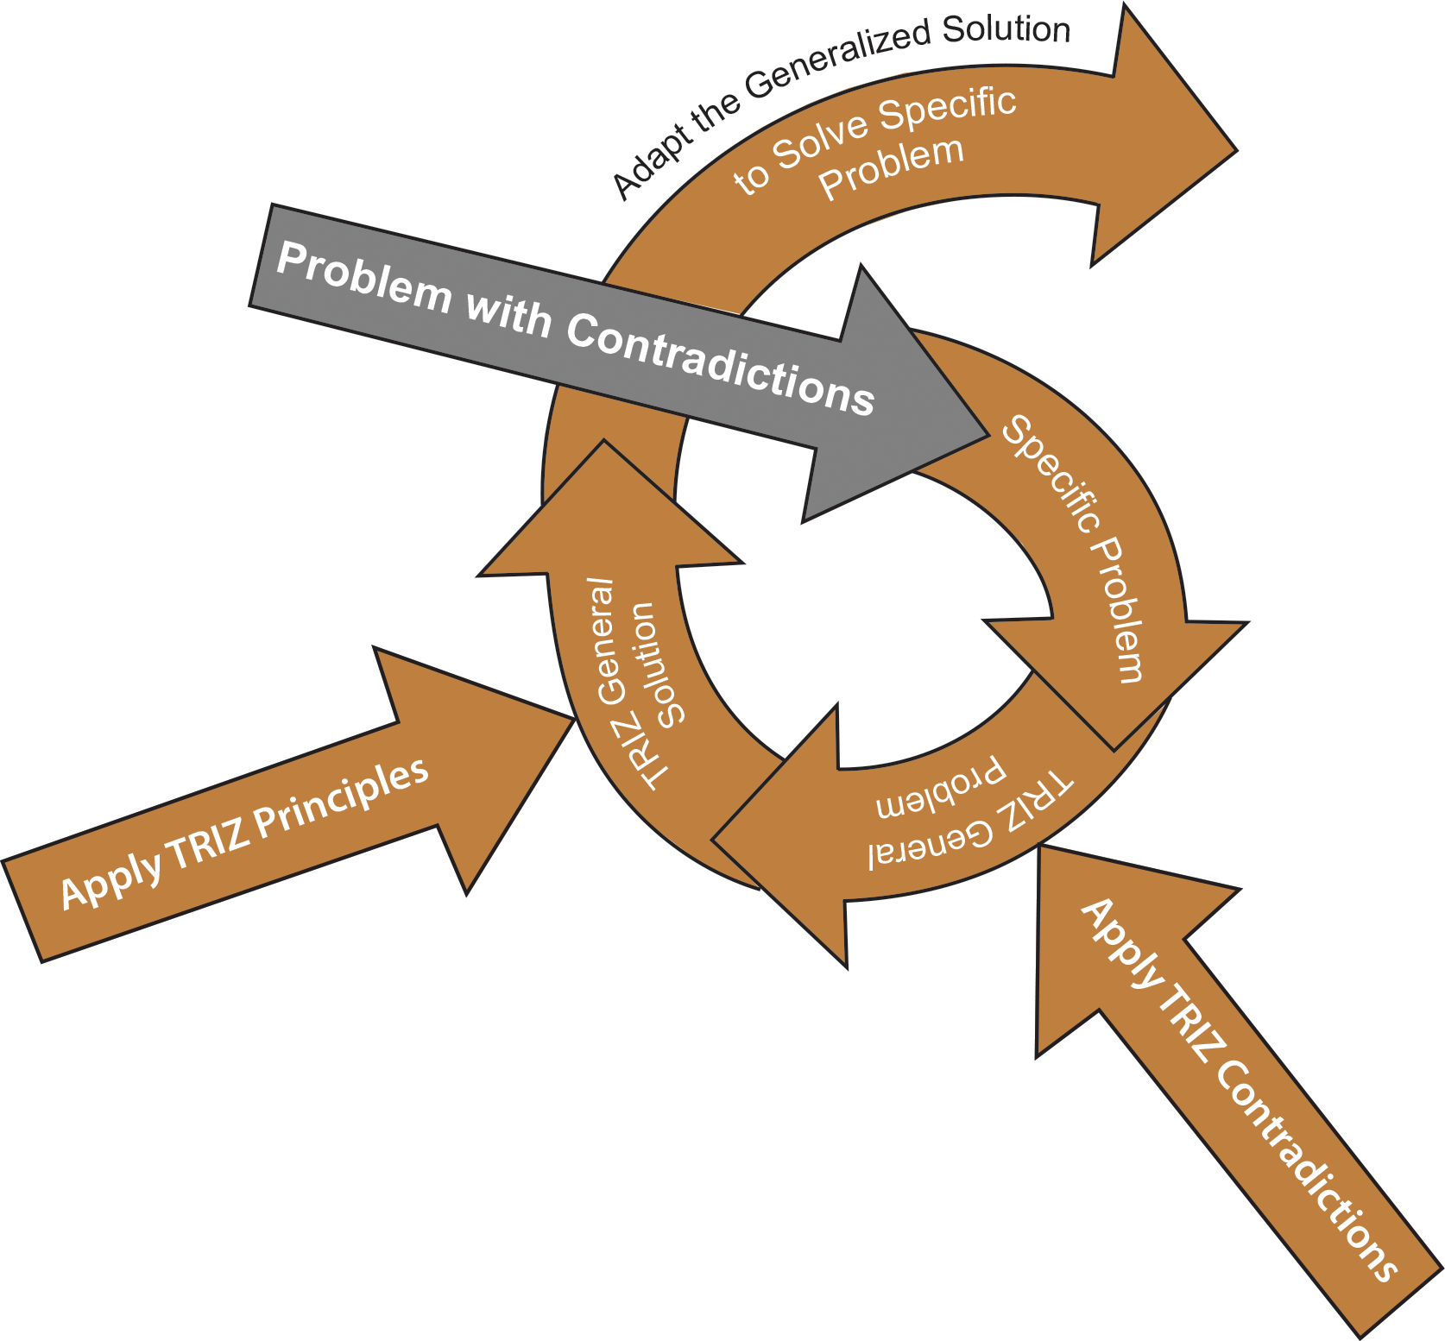
TRIZ Problem Solving Process
Identify the conflicting engineering characteristics (EC) with negative correlation in the HOQ correlation matrix.
Identify the EC’s type, which one is improving and which one is worsening characteristics.
Replace the ECs with corresponding parameters from TRIZ 39 contradiction matrix (Tables 3.1 through 3.6).
Using the contradiction matrix tables, identify which of the 40 inventive principles is applicable for your problem to resolve the contradiction (see Table 3.8 for 40 inventive principles).
After brainstorming, adapt the appropriate solution from 40 inventive principles to resolve the conflict among the ECs in the HOQ correlation matrix.
Re-construct the HOQ with the new ECs.
Figure 3.3: TRIZ problem solving process (adapted from reference 7).

Slide 7
Contradictions
A contradiction is a situation of two parameters in opposition to one another. There is three kinds of contradictions in TRIZ: administrative, technical, and physical contradictions.
Administrative contradiction: It is temporary, has no heuristic value, and stays at the surface of the problem.
Technical Contradiction: Technical contradictions are the typical engineering “trade-offs.” When something gets better, something else is affected and gets worse.
Example: The part products get stronger (good) but the weight increases (bad).

Slide 8
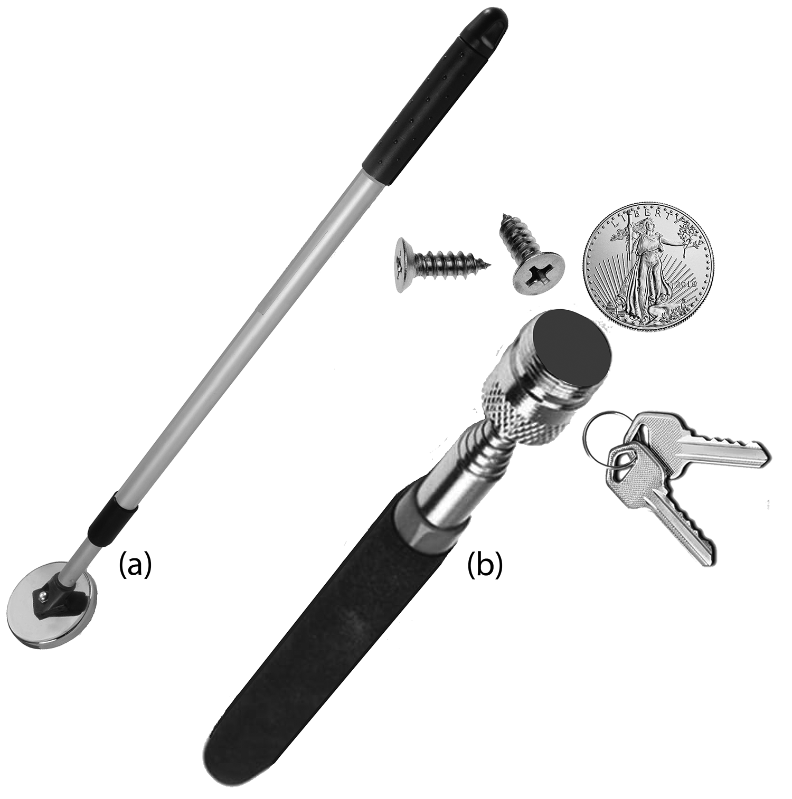
Physical Contradiction: Technical contradictions occurs between two parameters whereas a physical contradiction occurs when there is a conflict within a parameter itself.
For example, if we use a long regular magnetic tool to pick up several objects as shown in Figure 3.4(a), it may not be handy to carry. If we use a shorter magnetic tool for the same reason it may not be long enough to reach. In this case, the length of the tool is a parameter that creates a contradiction within a parameter (length) itself.
There are several ways of solving this contradiction. For example, if we use a telescopic magnetic tool to pick up various objects as shown in Figure 3.4(b), it is short enough to carry easily and if we extend it will be long enough to reach.
Figure 3.4: Magnetic pickup tool: (a) regular, (b) telescopic.

Slide 9
EXAMPLE
New material for aircraft structural parts needed. The design of an aircraft takes into consideration a variety of factors, one of the most important ones is the strength to weight ratio of the aircraft structural parts. The strength/weight conflict plays an important role in the design of aircraft structural parts. Use TRIZ analysis to resolve the conflict that will improve the strength/weight ratio.
ANALYSIS OF STATEMENT
Aircraft structural parts should be strong, but not heavy.
STEP 1:
Identify the contradiction(s) -- Strength (improves) versus Weight (worsens)
STEP 2:
Check Tables 3.1 through Table 3.6 and identify the improving and worsening features -- Strength – #14 and Weight – #2 (see Table 3.1)

Slide 10
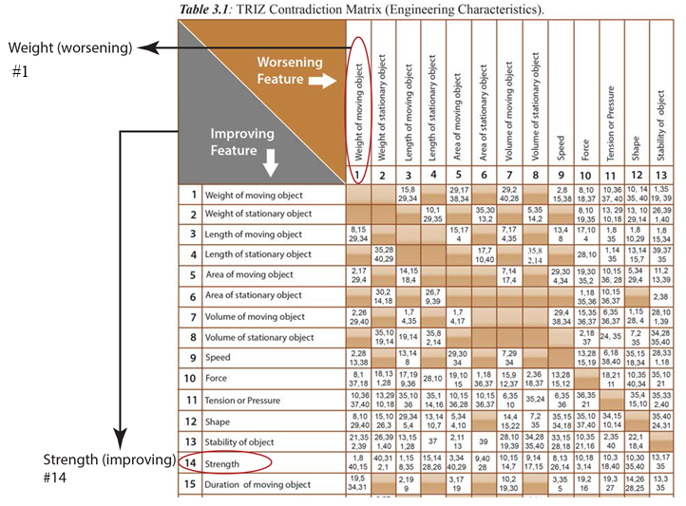
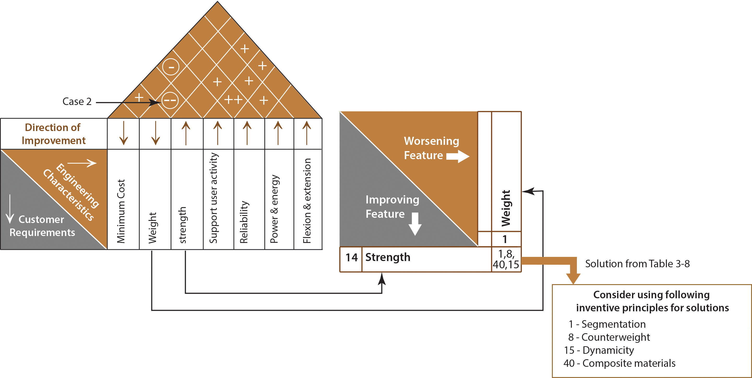
EXAMPLE (Continued)

Slide 11
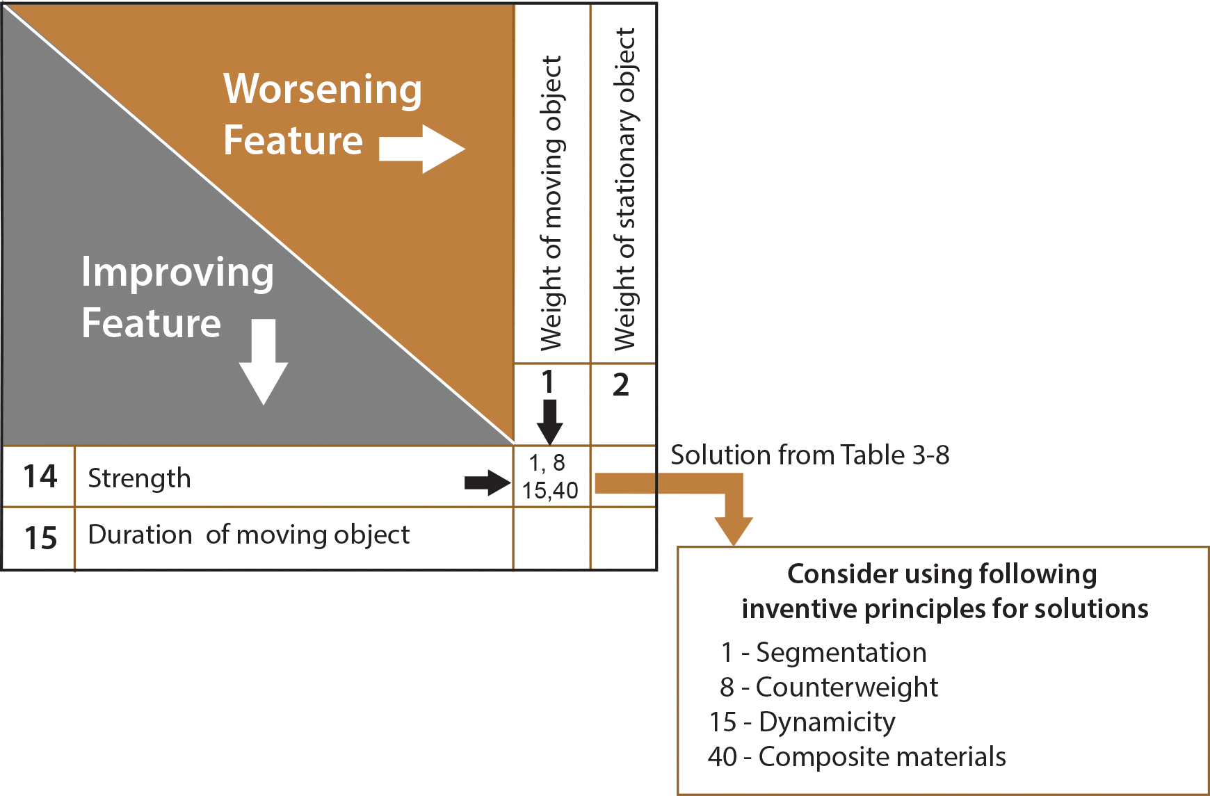
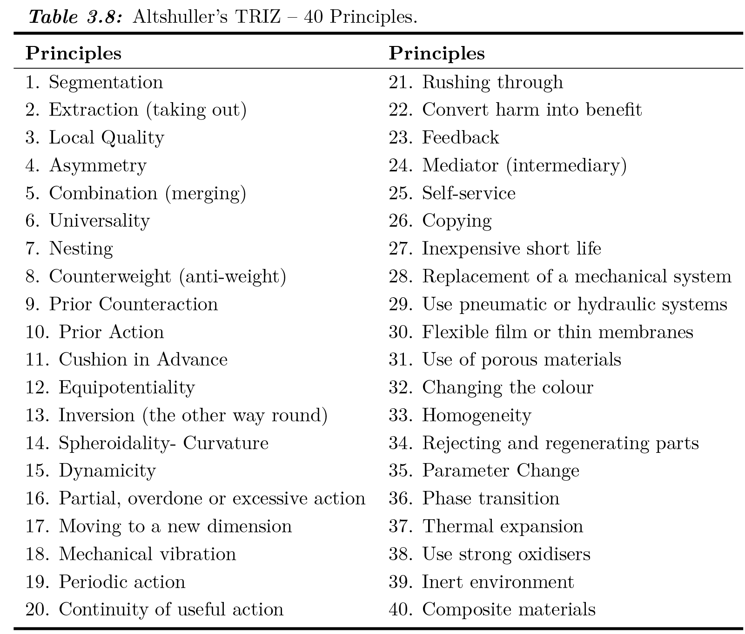
STEP 3:
Identify which principles can be used for this problem (see Figure 3.5).
Figure 3.5: Identifying improving and worsening features.
STEP 4: Next step is to think about which principle is useful to solve our problem. Principle 40 (composite material) is the most useful solution for this problem.

Slide 12
TRIZ Separation of Principles
There is four separations of principles to resolve physical contradiction:
Separation in time
Separation in space
The Separation between the parts (components) and the whole (system)
Separation upon condition

Slide 13
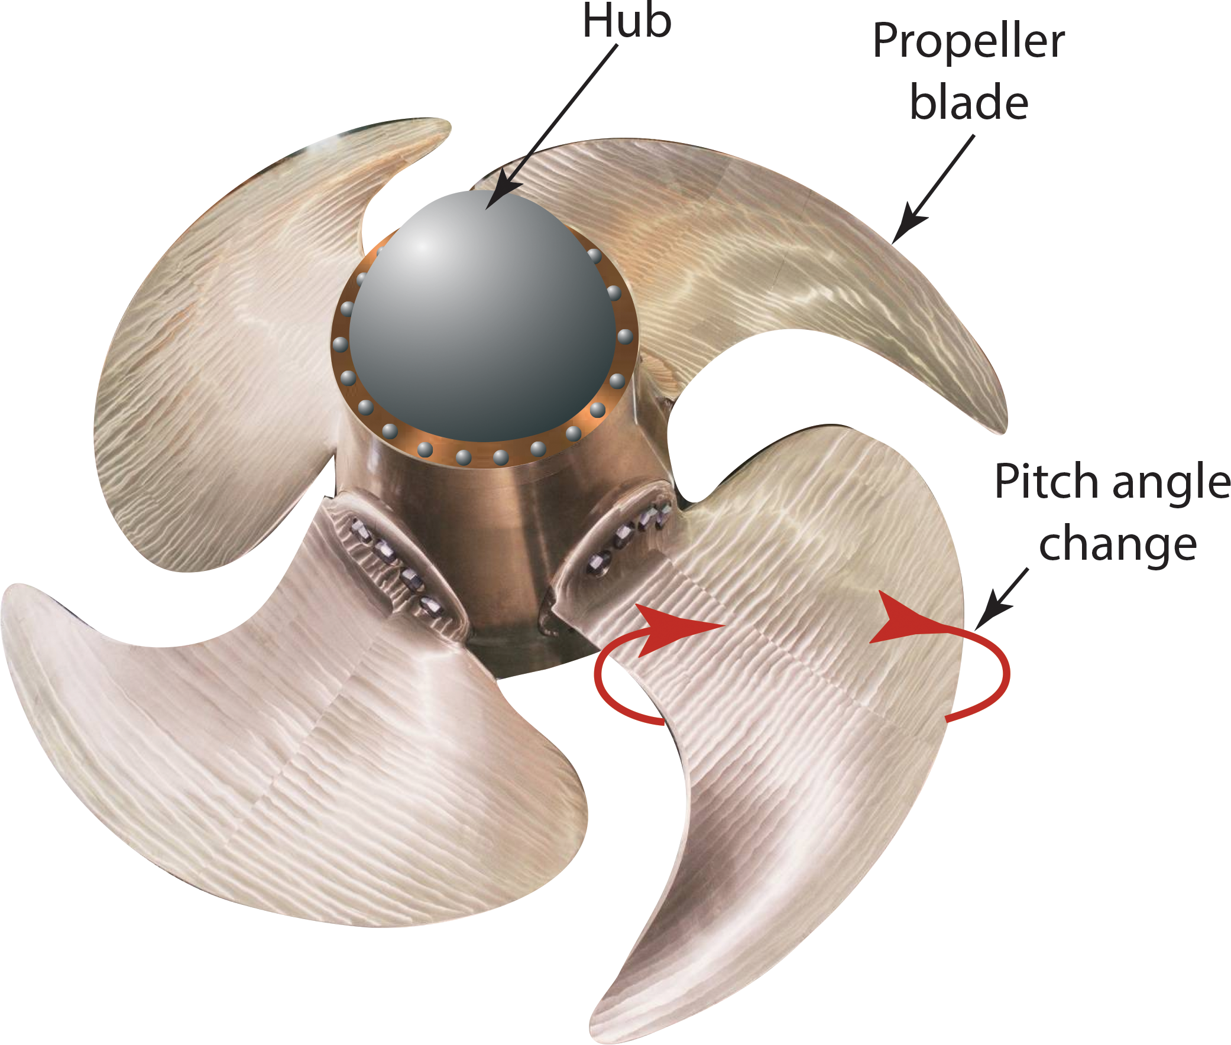
1. Separation of Conflicting Properties in Time
Changing a property, response, and behavior vs. time. For example, by changing the cargo ship propeller blades to the optimal pitch in time, higher efficiency can be obtained, thus saving fuel (see Figure 3.6).
Applying separation in time results in an inventive solution of controllable pitch propellers. Changing the pitch of the propeller in time will run the ship in forwarding and astern directions both, without the change of engine rotational direction.
From Table 3.8, TRIZ principles most applicable to “separation in time” are: 9, 10, 11, 12, 15, 16, 18, 19, 20, 21, 35, 36, 37, 38, and 39.
Figure 3.6: Controllable pitch propeller.

Slide 14
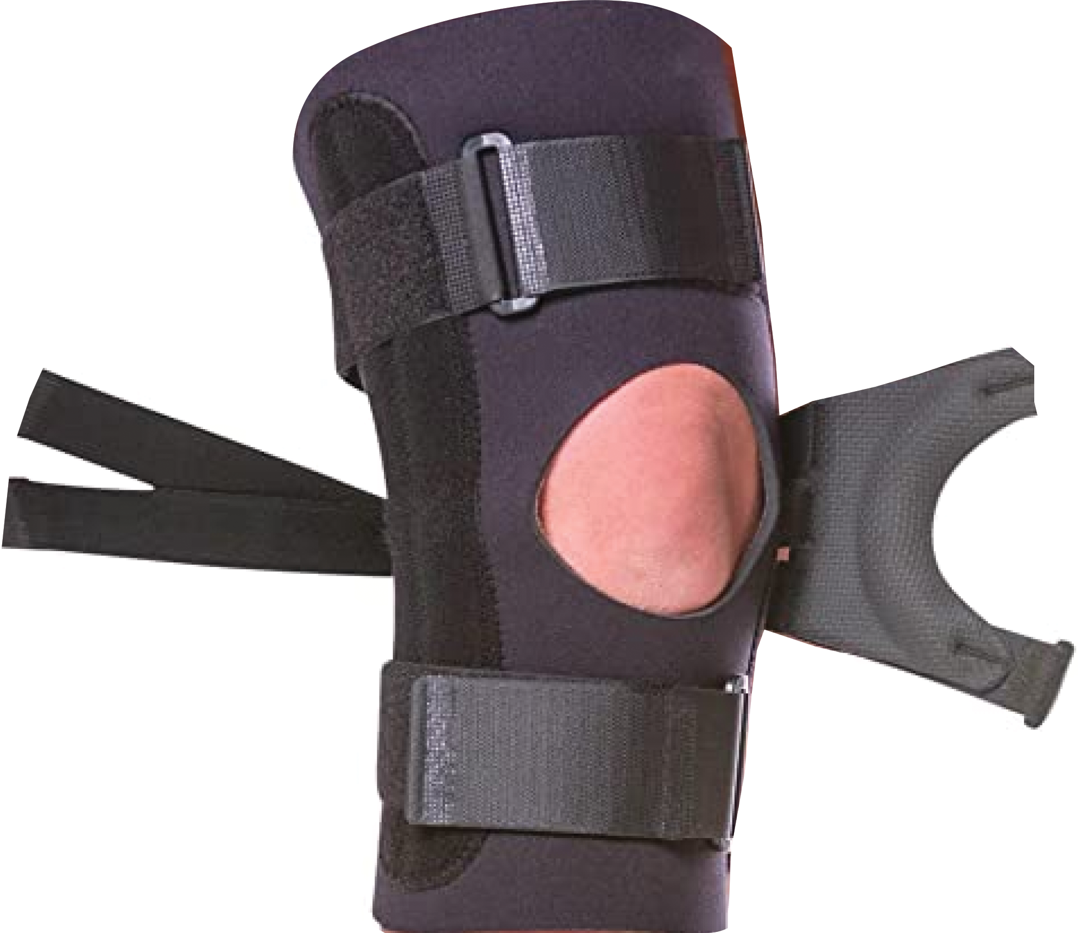
2. Separation in Space
Changing a property, response, behavior based on a special location. From Table 3.8, TRIZ principles most applicable to “separation in space” are: 1, 3, 4, 5, 7, 8, 13, 14, 15, 16, 17, 26, 27, 30, 31, and 32.
Example: A knee brace is used after a knee injury to provide support while the knee injury is healing. They are designed to limit movement of the knee while it is healing after an injury or surgery. However, certain conditions will cause the kneecap to track improperly, causing pain in other locations. The pain is present in one place (around the knee joint) and absent in another place. The solution is having a small hole as shown in Figure 3.7 to support the kneecap.
Figure 3.7: Knee brace.

Slide 15
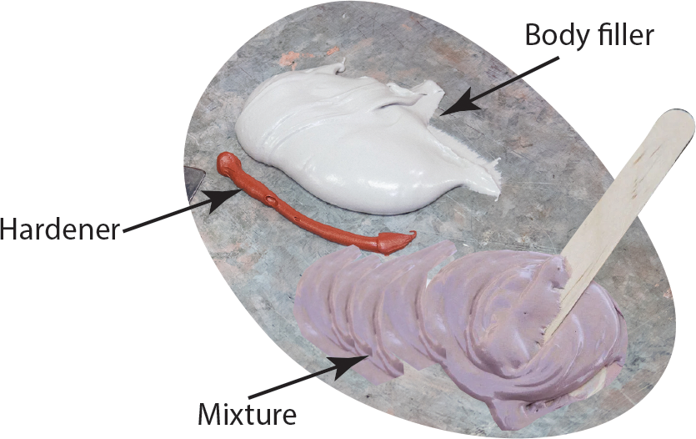
3. Separation between the Parts and the Whole
Changing a property, response, and behavior to make it different at the component or system level. In other words, exists at the system level but not exist at the component level (or vice versa).
For example plastic body fillers and hardeners shown in Figure 3.8 are liquids, but when you mixed them combination became solid.
Table 3.8, TRIZ principles most applicable to “between parts and the whole” are 2, 3, 6, 7, 24, 26, 27, 33, 34, and 40.
Figure 3.8: Mixing body filler and hardener.

Slide 16
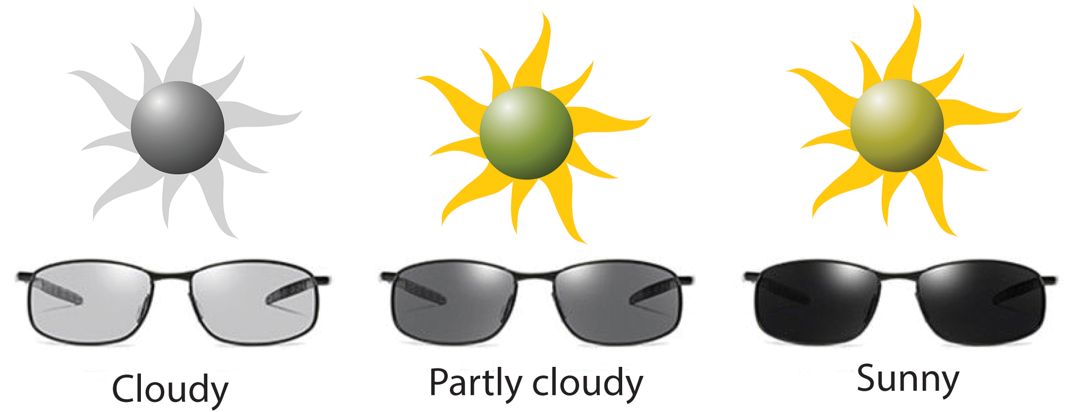
4. Separation upon Condition
Changing the property, response, or behavior on condition. Properties can be high under one condition and low under another condition.
A good example of this case is transitions lenses with a light-sensitive photochromic coating as shown in Figure 3.9. The lenses are light or dark changing on the conditions of UV radiation present.
From Table 3.8, TRIZ principles most applicable to “separation of conditions” are 6, 15, 16, 18, 19, 22, 28, 29, and 32.
Figure 3.9: Light-sensitive photochromic coating lenses.

Slide 17
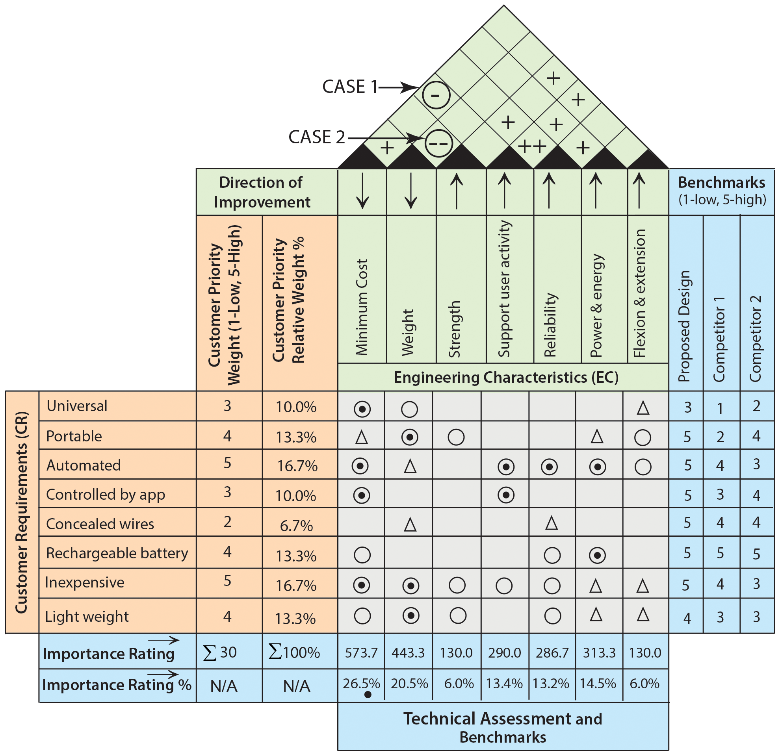
CASE STUDY
Using the TRIZ inventive principles resolve the conflicts among the ECs shown in Figure 3.10.
Two negative correlations occur:
CASE 1: Cost (worsening characteristic) and Support user activity (improving characteristics)
Case 2: Weight (worsening characteristic) and Strength (improving characteristics)
Figure 3.10: HOQ.

Slide 18
CASE STUDY (continued)
Case 1: The improvement of the “support user activity” causes an increase of production “cost”.
Cost reduction is a widespread topic throughout the industry. However, many techniques of TRIZ do not deal with cost explicitly.

Slide 19
CASE STUDY (continued)
Complexity of the system/device
Complexity of control
System-generated harmful factors
Time and risk issues for the R&D, Production,
Supply, and Support
Speed of a process
Duration of action
Loss of energy, loss of material, loss of
information, loss of time
Reliability
System-generated harmful factors
Ease of operation, ease of production, ease of repair
System complexity
Extent of automation
Productivity
Darrell Mann (2004) included some of the same parameters used in the TRIZ matrix that cause costs to increase.
For Case 1, we adopt “complexity of device” (worsening characteristic ) for “cost of production” and “ease repair (repairability)” (improving characteristic) for “support user activity”.

Slide 20
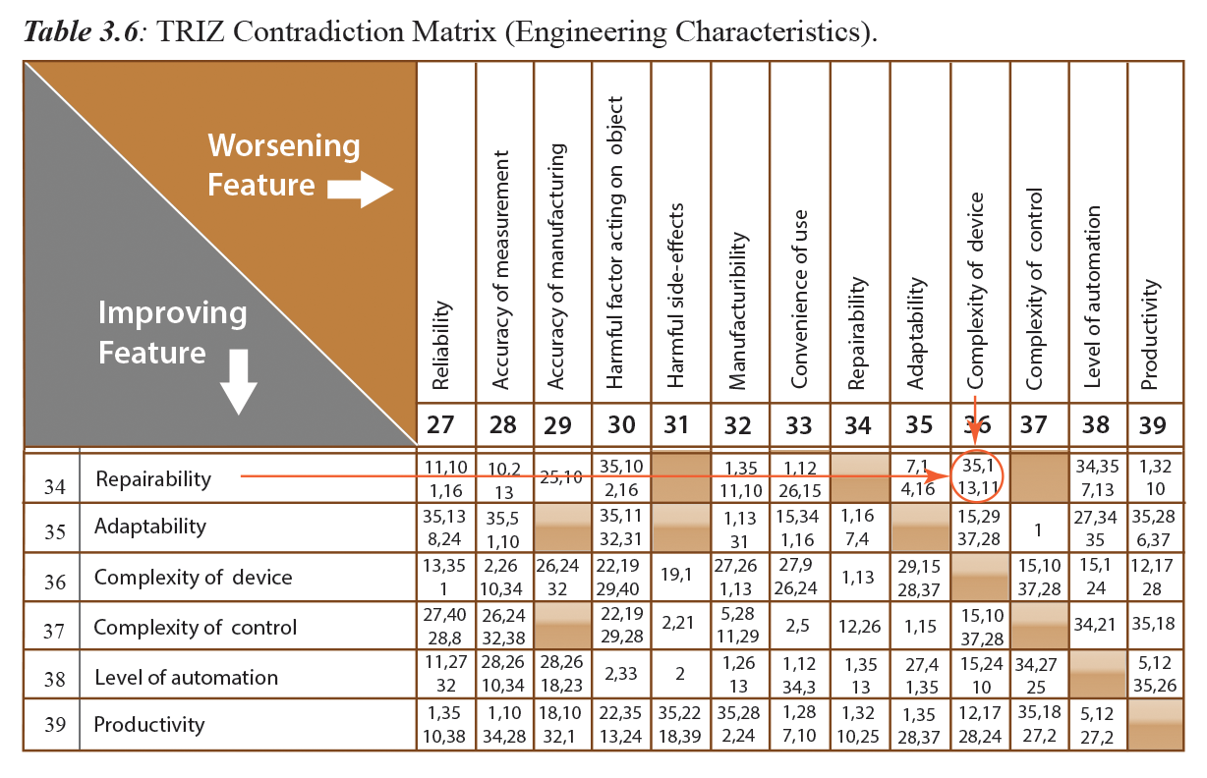
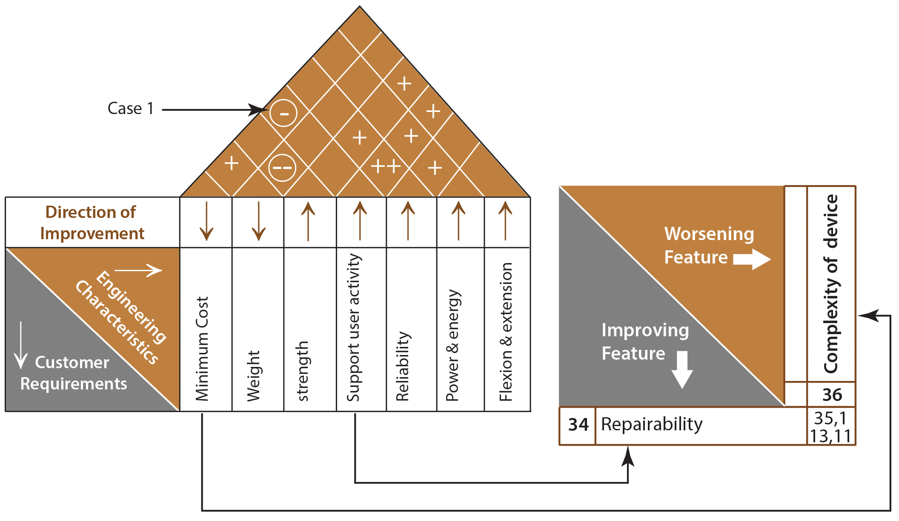
CASE STUDY (continued)
SOLUTIONS ARE: 35, 1, 13, 11

Slide 21
CASE STUDY (continued)
Solutions from Table 3.8 are: 35, 1, 13and 11.
35-Parameter change – change an object’s physical state (e.g. to a gas, liquid, or solid).
1-Segmentation – divide an object into independent parts.
Replace mainframe computers with personal computers
Replace a large truck with a truck and trailer
Use a Work Breakdown Structure (WBS) for a large project.
13-Invertion (the other way around) – invert the action(s) used to solve the problem (e.g. instead of cooling an object, heat it).
11- Cushion in Advance - Prepare emergency means beforehand to compensate for the relatively low reliability of an object.

Slide 22
CASE STUDY (continued)
Solution Decision
After thorough analysis, the principle 1- segmentation of “use a Work Breakdown Structure (WBS) for a large project,” will be implemented. A WBS helps to make a large project more manageable. Breaking it down into smaller pieces work can be done simultaneously by different team members, leading to better team productivity. This will save a lot time and effort, ultimately, saves money and reduces the production cost.

Slide 23
CASE STUDY (continued)
CASE-2: The improvement of the“ strength” causes an increase of “weight”, thus resulting in a strong negative correlation in the correlation matrix.
In this case,
Strength is the improving characteristic
Weight is a worsening characteristic.

Slide 24
SOLUTIONS ARE: 1, 8, 15, 40

Slide 25
From TRIZ Tool we have
(1) Segmentation – divide an object into independent parts.
(8) Counterweight – to compensate for the weight of an object, merge it with other objects that provide lift.
(15) Dynamicity – allow (or design) the characteristics of an object, external environment, or process to change to be optimal or to find an optimal operating condition.
(40) Composite material – change from uniform to composite (multiple) materials.
Composite epoxy resin/carbon fiber golf club shafts are lighter, stronger, and more flexible than metal. Same for airplane parts.
Fiberglass surfboards are lighter and more controllable and easier to form into a variety of shapes than wooden ones.
SOLUTION
For this case, among the other suggested solutions, composite material (40) will lead to a solution. This solution will eliminate the contradiction between weight and strength.

Slide 26
U.S. Department of Energy defines WBS as “A WBS is the cornerstone of effective project planning, execution, controlling, statusing, and reporting. All the work contained within the WBS is to be identified, estimated, scheduled, and budgeted. The WBS is the structure and code that integrates and relates all project work (scope, schedule, and cost).” Therefore, the relationships of the engineering characteristics with this new characteristic (WBS) should be carefully reconsidered to re-build the HOQ. A similar argument is justifiable for the replacement of “composite material” in the HOQ.
A negative correlation between ECs, mainly “cost of production” and “weight (material)”,
certainly affects the performance of product design. Thus, these ECs, which have negative correlations are replaced in the HOQ as shown in Figure 7.8.

Slide 27
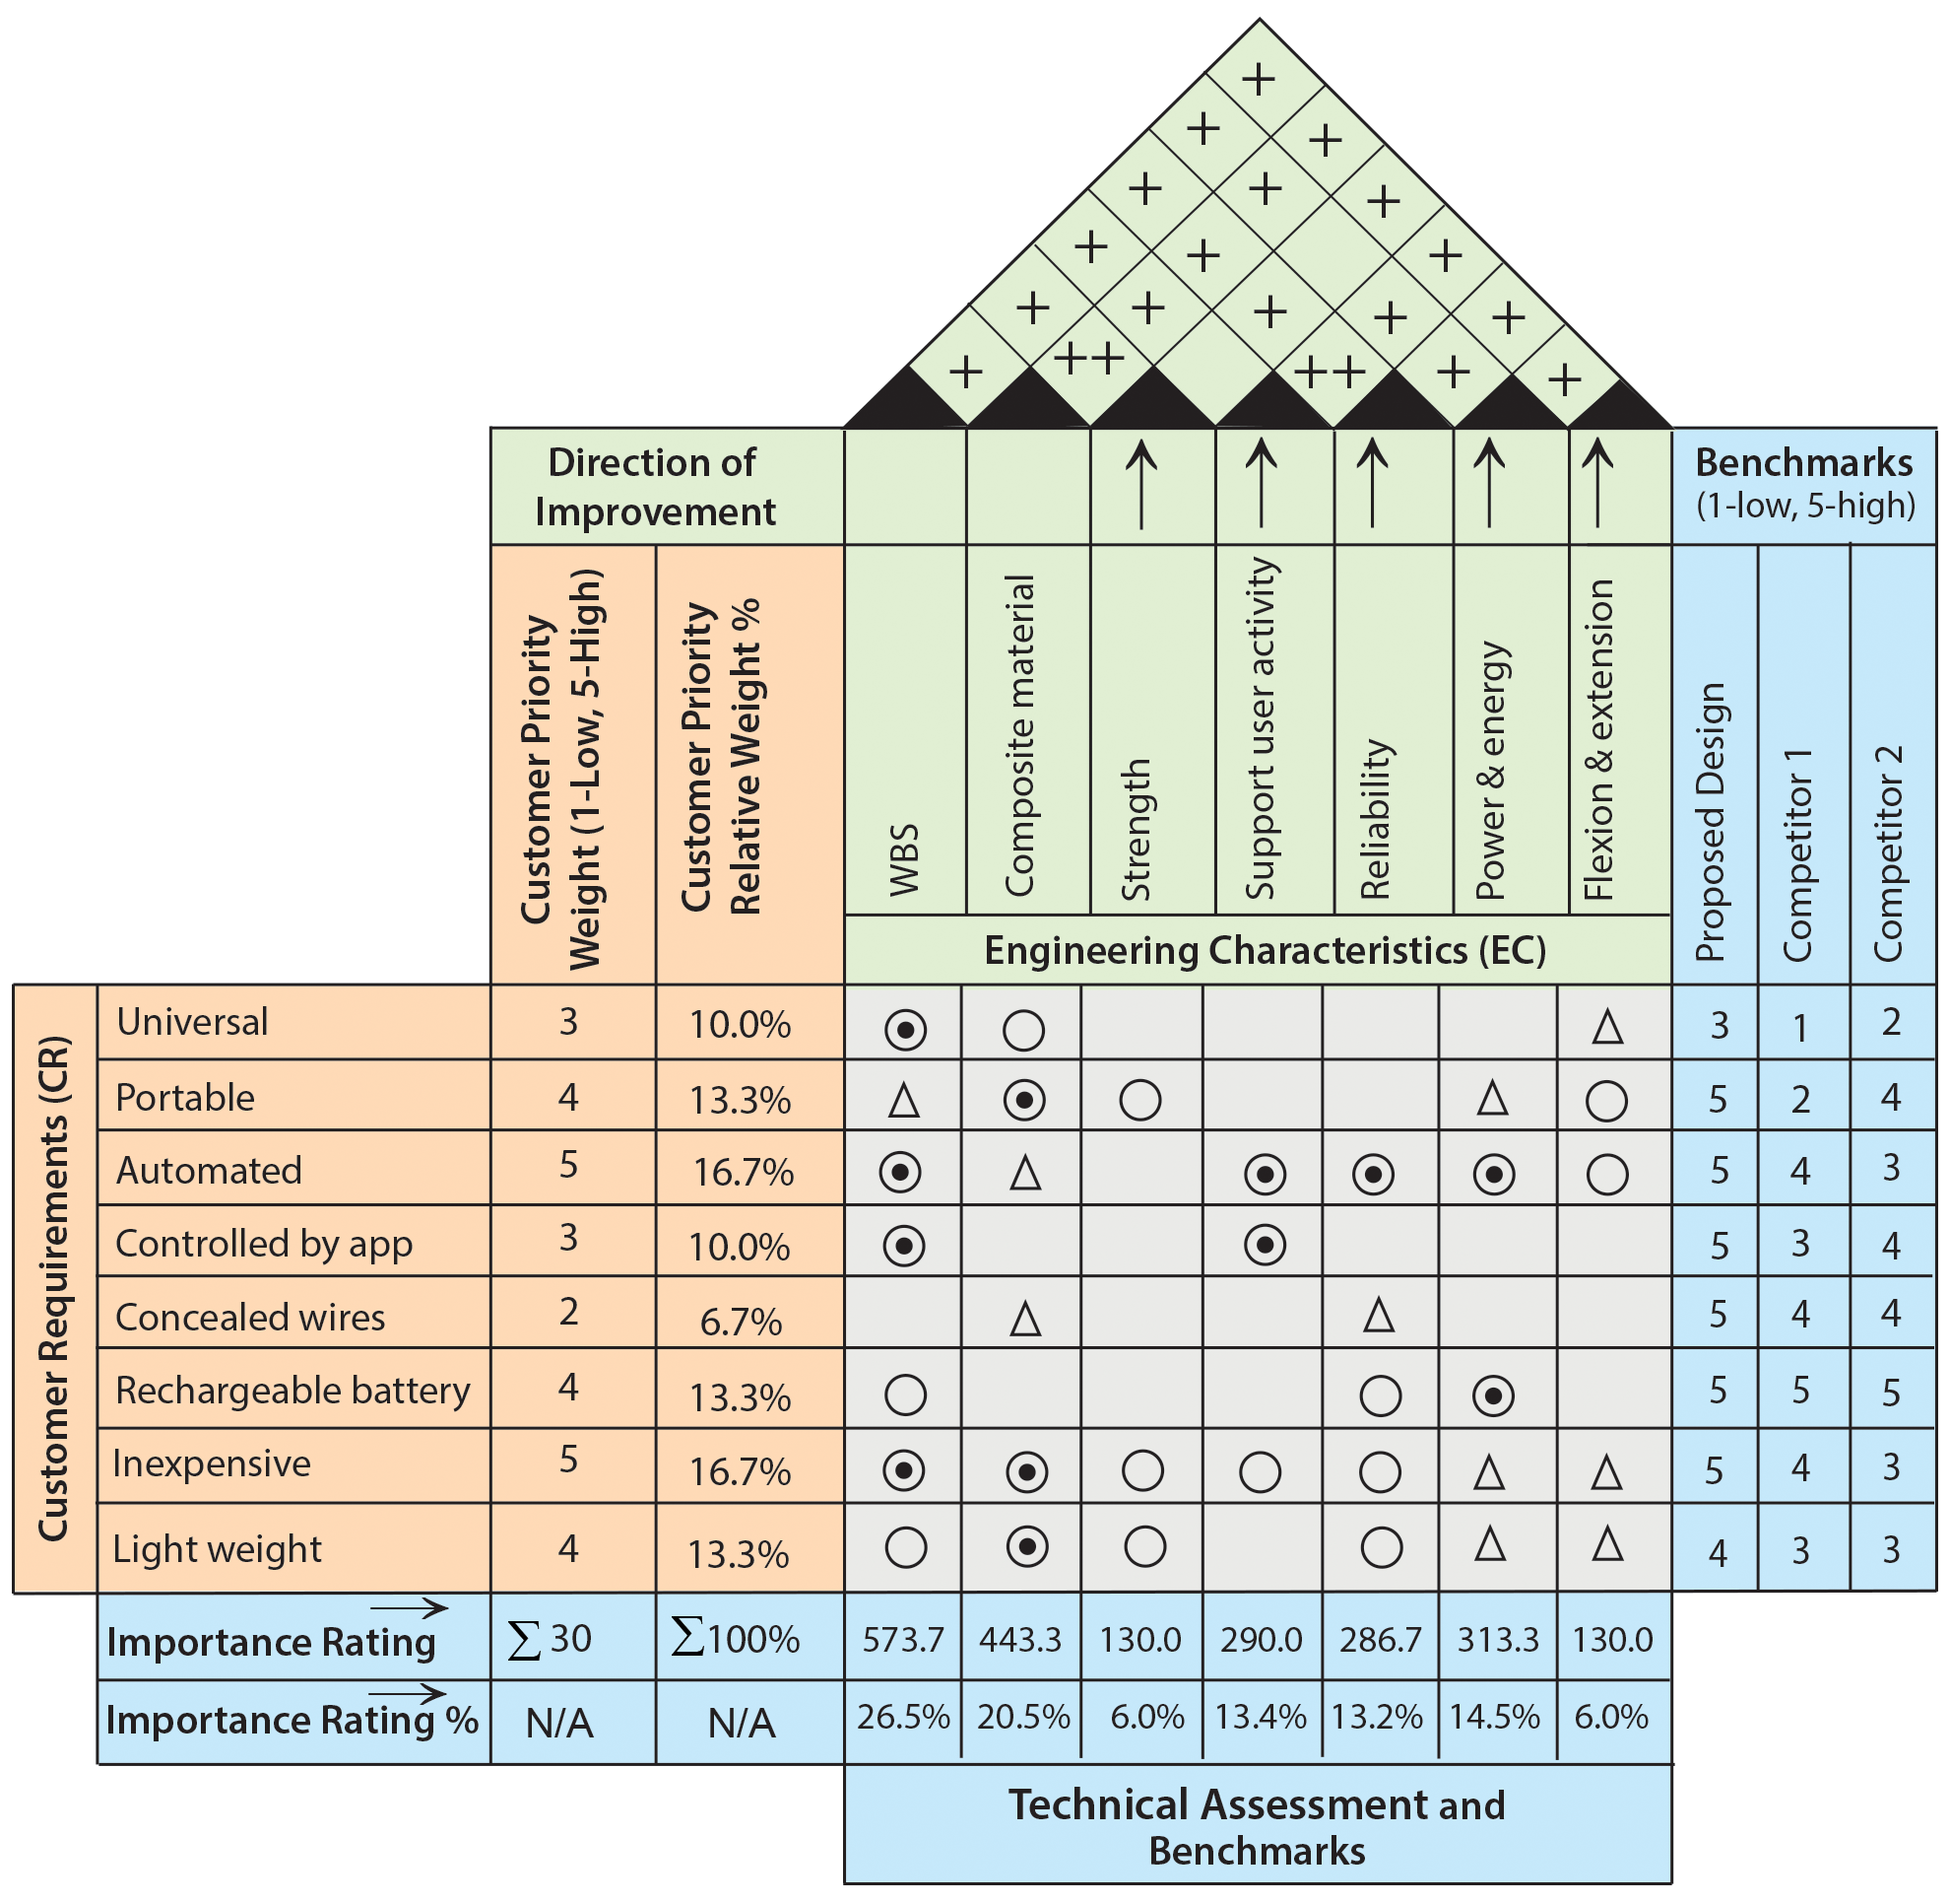
RE-BUILDING HOQ
Make sure that you re-evaluate the correlations among the engineering characteristics for the new HOQ.
Figure 7.8: New re-build HOQ.

Slide 28
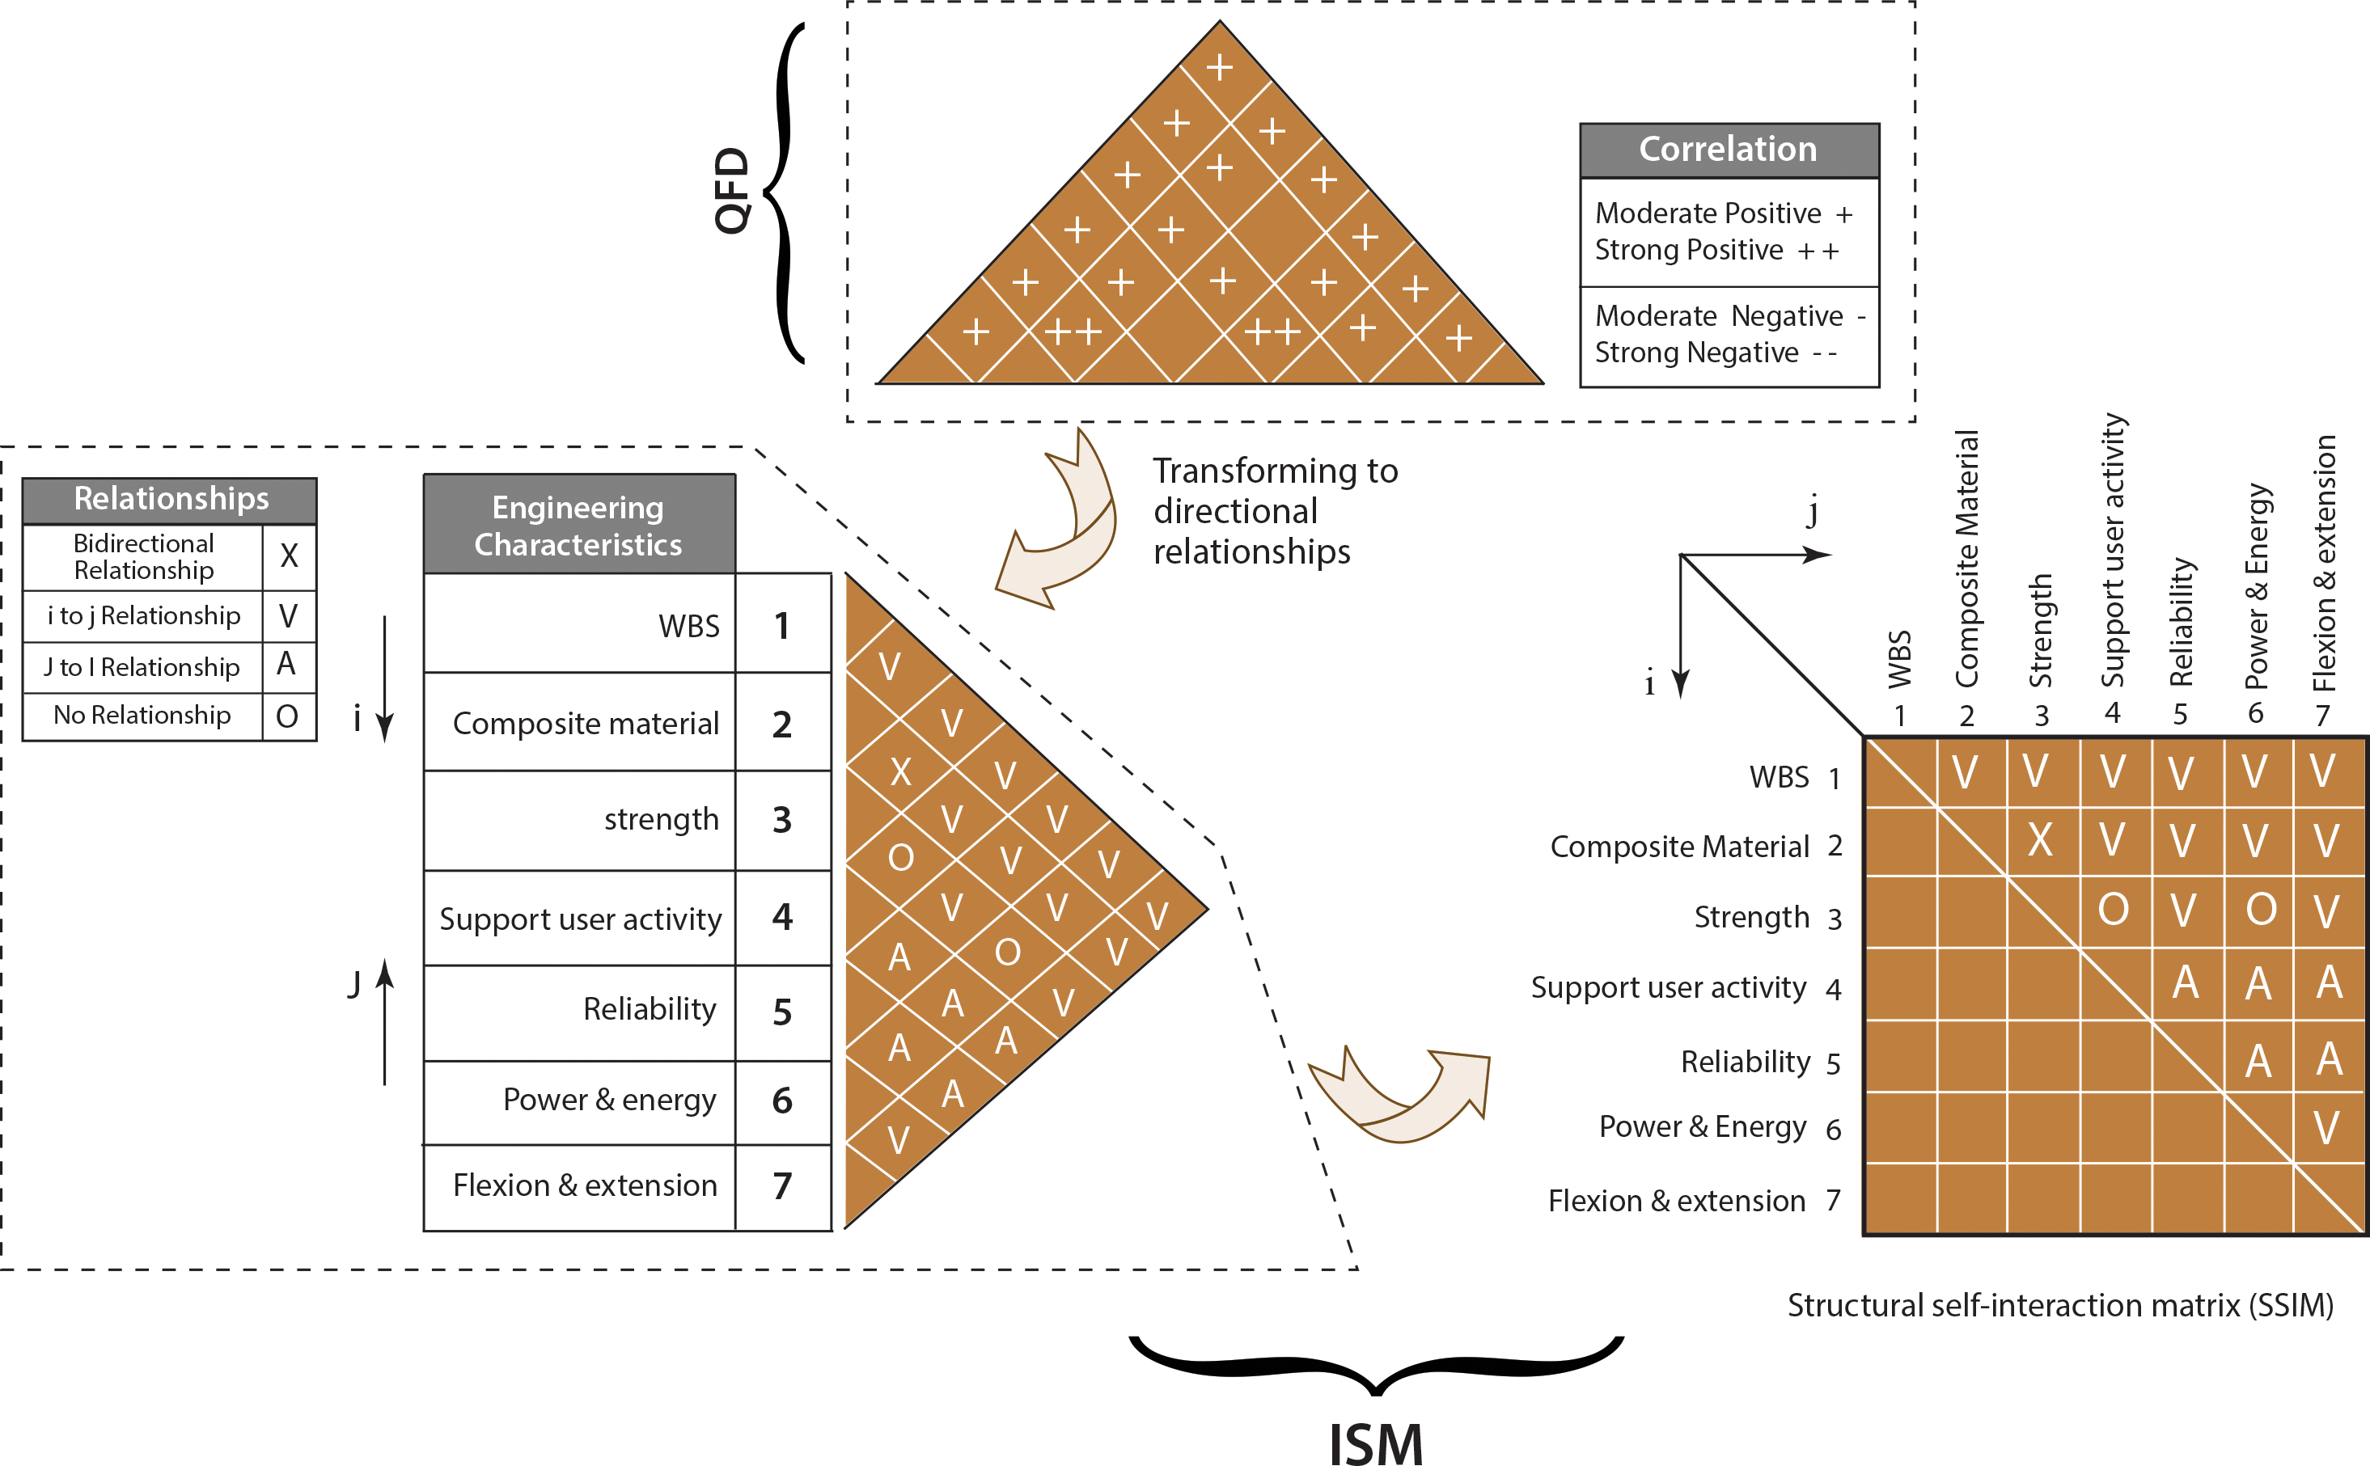
Transforming QFD results to ISM

